Slide 1
Pyroelectric Energy Harvesting Devices
Student Design Team:
Trent Borman¹, John Etherington², Thomas Geske¹, Joshua Grindeland²
Faculty Advisors & Clients:
Scott Beckman¹ and Sumit Chaudhary²
Donor:
Pete Onstad (to foster EE/MSE senior design collaboration)
¹ Department of Material Science and Engineering; Iowa State University; Ames, Iowa; USA
² Department of Electrical and Computer Engineering; Iowa State University; Ames, Iowa; USA
Notes:
Introduce ourselves, project, and advisors/client

Slide 2
Problem Statement
Convert waste thermal energy to electricity.
Design a system to utilize the pyroelectric effect in materials with high entropy transitions.
Notes:
John
Convert waste thermal energy to electricity.
Design a system to utilize the pyroelectric effect in materials with high entropy transitions.

Slide 3
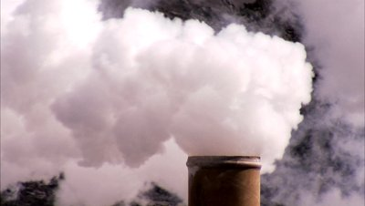
Market Survey
Waste heat is abundant
No clear industry leader in thermal energy to electric energy conversion
Modern high entropy materials exceed bulk ceramics in performance
Notes:
John
$10,000/k
If they ask: (DO NOT STATE THIS) Thermoelectric devices have drawbacks. The main drawback is that electrical and thermal conductivity are extremely hard to decouple. They also require a high thermal gradient while pyroelectric materials can be used in a very tight temperature range.

Slide 4
Background &
Motivation
Notes:
Trent

Slide 5
Coupling Thermal and Dielectric Properties
A pyroelectric crystal spontaneously changes polarization when its temperature is changed
The electrocaloric effect is when a crystal spontaneously changes temperature when its polarization changes
The pyroelectric effect allows us to convert between thermal energy and electrical energy
Notes:
Trent
It can be used to extract electric energy from thermal gradients
It can also be used to convert electrical energy to thermal gradients
Think of it like a capacitor that has a variable dielectric constant that is controlled via temperature
Using this variability we can extract energy from the system

Slide 6
Basic Operation of Engines and Refrigerators
Refrigerator
Thermal
Reservoir
(Hot)
Thermal
Reservoir
(Cold)
System
Work
Environment
Notes:
Trent
In a refrigerator work is put into the system and this moves heat between the cold and hot reservoir

Slide 7
Basic Operation of Engines and Refrigerators
Engine
Thermal
Reservoir
(Hot)
Thermal
Reservoir
(Cold)
System
Work
Environment
Notes:
Trent
Conversely for an engine, heat flows from the hot reservoir to the cold, passing through the system doing work

Slide 8
Engine & Refrigerator in Phase Space
Engine
Refrigerator
Pressure
Pressure
Volume
Volume
Notes:
Trent
The difference between a refrigerator is the direction of heat flow. This can be seen in tracing the ‘work’ loop in different directions. Ideally this is a reversible process.
There are many forms of thermodynamic work other than Pressure-Volume. (e.g. chemical potential-number of moles, surface free energy-area work
Polarization-Electric Field work causes the charges in the dielectric material to rearrange under an electric field. This is the type of work we are using in our system

Slide 9
Common Engineering Principles
A material is used to transfer heat between thermal reservoirs
Complementary adiabatic processes facilitate the thermodynamic cycle
Adiabatic Transformation
Equilibrate with hot thermal reservoir
Equilibrate with cold thermal reservoir
Adiabatic Transformation
Notes:
Trent
Define Adiabatic – no transfer of heat or matter between system and surroundings (insulated)
Energy is harvested in our system when our device is heated up. (HOT RESERVOIR)

Slide 10
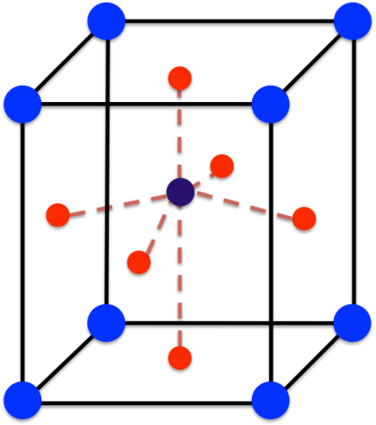
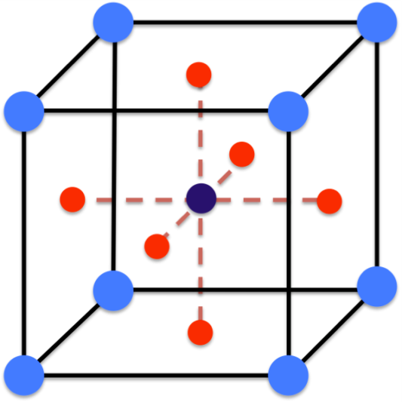
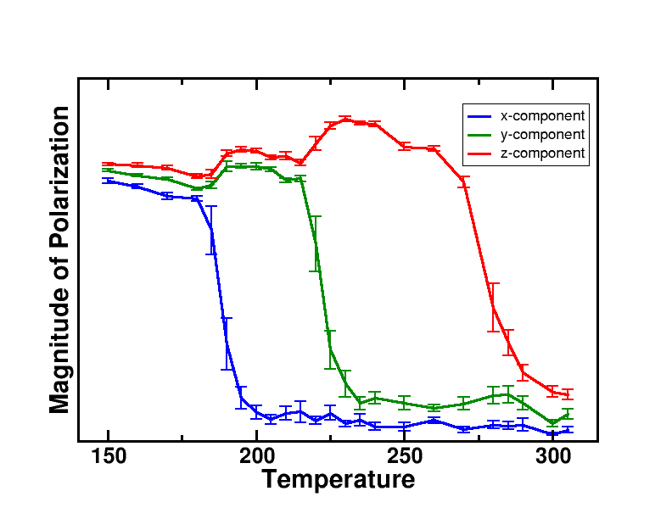
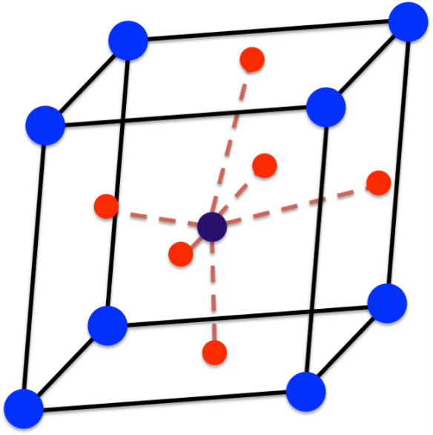
Example: Perovskite pyroelectric crystal: ABO₃
-ΔT
-ΔT
BaTiO₃
-ΔT
Figure courtesy of Dr. Beckman
Notes:
Trent
On a materials level this is how the pyroelectric effect works. The material goes through a phase transition and this is how a thermodynamic loop occurs.
With more symmetry the polarization drops off; the curie temperature is when the material is in a completely symmetric form. This is where the largest energy generation occurs

Slide 11
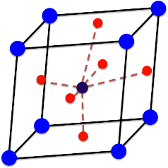
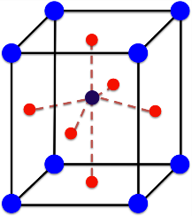
Electric work
Polarization
T_{low}
T_{high}
Electric Field
Notes:
Trent
By changing the temperature of the system we can trace out a loop in thermodynamic space
By cycling temperature and electric field, large loops can be traced in Polarization-Electric Field space.

Slide 12
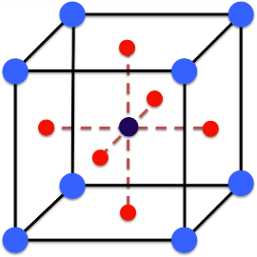
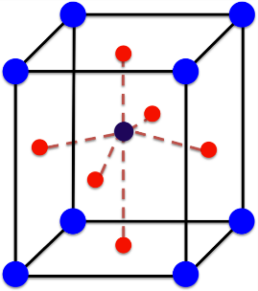
Why does this work?
The ordering of atomic scale dipoles causes a change in the entropy
-ΔT
Field Direction
The change entropy requires a change in heat
In an adiabatic system, this causes a change in temperature
Notes:
Trent
The moving of dipoles causes a change in entropy. When a change in entropy occurs energy harvesting can occur

Slide 13
Pyroelectric vs. Thermoelectric
Oscillating thermal cycle
Dipole orientation
Applied electric field
Exhibited by few materials
Static thermal gradient
Charge carrier motion
No applied field
Exhibited by all materials
Notes:
Trent

Slide 14
What can we use to get a larger change in entropy?
Notes:
Tommy
This where our design actually begins!

Slide 15
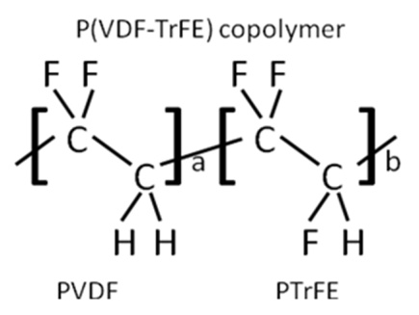
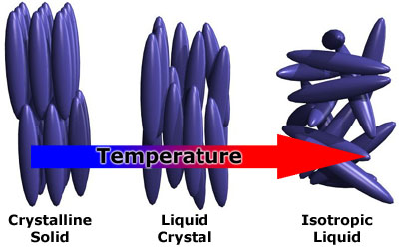
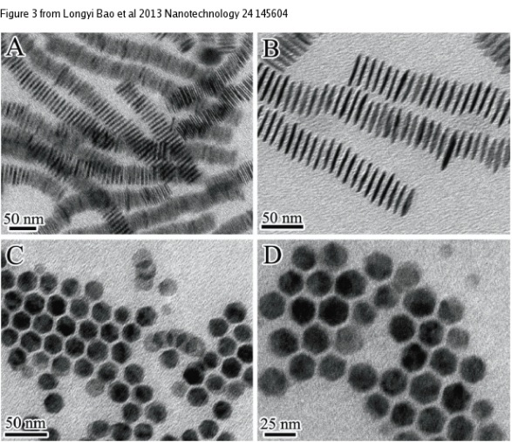
Polymers
Liquid Crystals
Nanostructures
Figure from Longyi Bao
Nanotechnology (2013)
Notes:
Tommy
***To get a larger entropy change we can use polymers, liquid crystals, and nano sheets which are larger molecules. With more atoms moving we get a larger entropy change.
It should also be noted that all of these materials must exhibit a phase transiotion

Slide 16
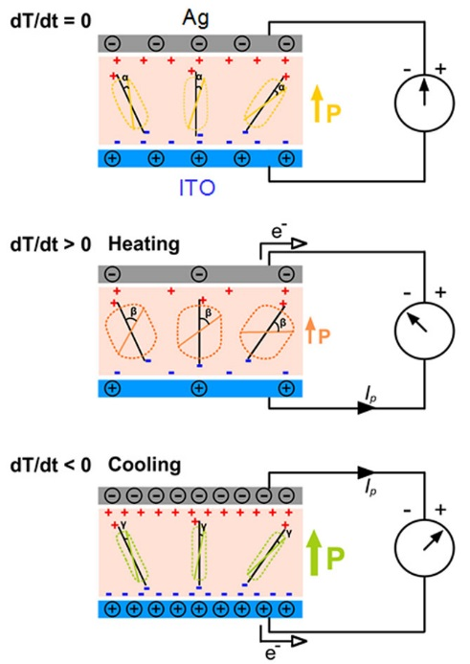
Material Effect
Polarization
Electric Field
Figure from Yyang340 - Wikipedia
Notes:
Tommy
So going back to the picture we used earlier we can show how these novel materials act on an atomic scale.
The heating polymer picture occurs at the bottom left hand corner, The cooling polymer picture occurs at the top right.

Slide 17
Goals & Progress
Notes:
Josh

Slide 18
Functional Requirements
Demonstrate the pyroelectric effect in liquid crystals and polymers
Convert waste heat to electrical work
Measure properties of specimens
Design a switching and harvesting circuit
Expose pyroelectric device to a thermal cycle
Withstand 400V across element
Notes:
Josh
Demonstrate the pyroelectric effect in liquid crystals and polymers
Convert waste heat to electrical work
Measure properties of specimens
Design a switching and harvesting circuit
Expose pyroelectric device to a thermal cycle
Withstand 400V across the terminals, or be appropriately isolated for sensitive devices (arduino)

Slide 19
Non-functional Requirements
Well documented for future work
Modular for varying pyroelectric materials
Scalable to significant current and power levels
Safety
Notes:
Josh
Well documented for future work (most previous work in this topic had very poorly documented circuits)
Modular for varying pyroelectric materials (so different pyroelectric devices can be inserted into the circuit)
Scalable to significant current and power levels (industrial applications)
Safety (high voltages, temperatures, chemicals)

Slide 20
Deliverables
Pyroelectric specimens
  Liquid crystal cells
  P(VDF-TrFE) films
Characterization circuit
  Electrical property measurements
Harvesting circuit
  Microcontroller code
Notes:
Josh

Slide 21
Risks
High risk project utilizing new, unproven materials and techniques
Potentially transformative for thermal energy harvesting industry
Notes:
Josh

Slide 22
Work breakdown
Trent Borman
-Group leader
-Liquid crystal device fabrication
-P(VDF-TrFE) device fabrication
-Material electrical property curves
-Management of bill of materials
John Etherington
-Project timeline
-Communication (weekly report)
-Control systems and control code
-Circuitry design
Tommy Geske:
-Bibliography and Sourcing
-Liquid crystal device fabrication
-P(VDF-TrFE) device fabrication
-Thermodynamic curve generation
Joshua Grindeland
-Web page design
-Circuitry design
-Pspice circuit design
-Electrical device research
Notes:
Josh

Slide 23
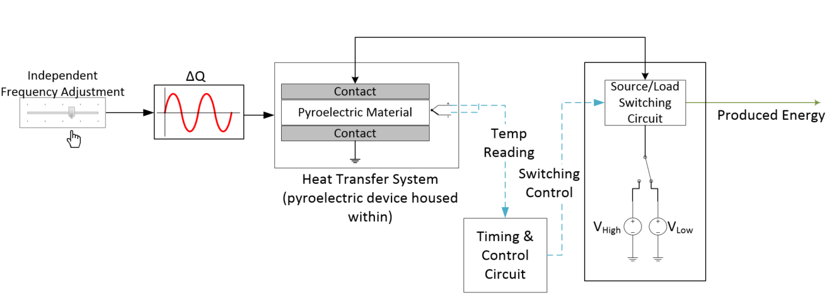
System Block Diagram
Notes:
Josh
Control frequency of thermal oscillations. Control system applies appropriate voltage and harvests at proper times.
Explain the block diagram!

Slide 24
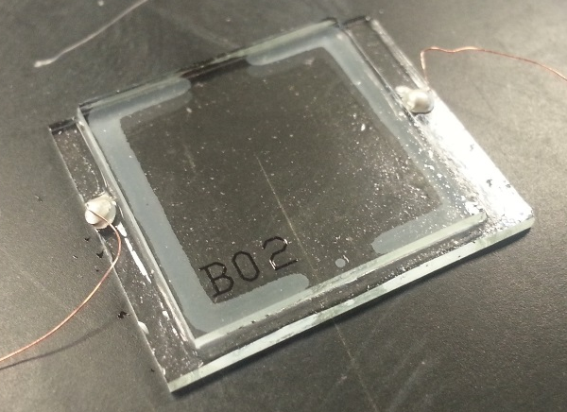
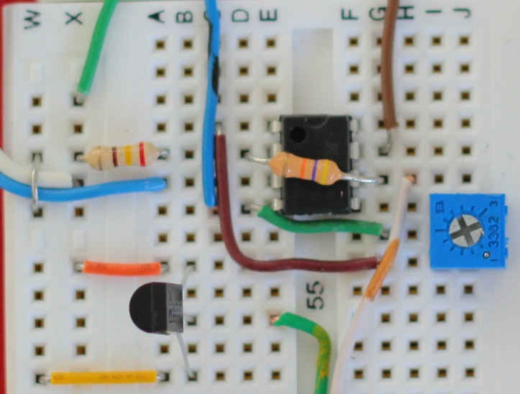
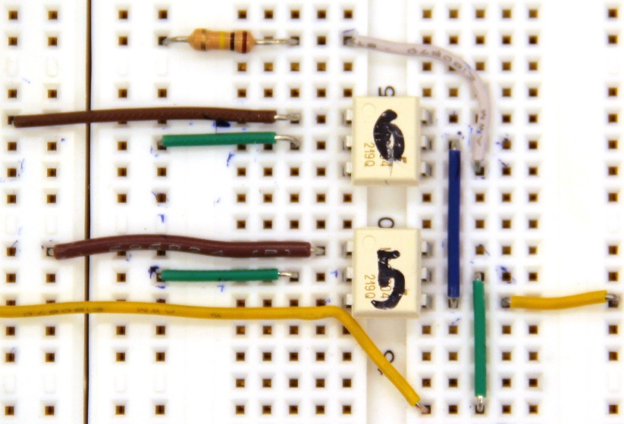
Design Stages
1
Pyroelectric specimens
Characterization circuit
Harvesting circuit
2
3
Notes:
Josh
First we must fully understand how the material performs. This data will enable us to configure the harvesting circuit and timing.

Slide 25
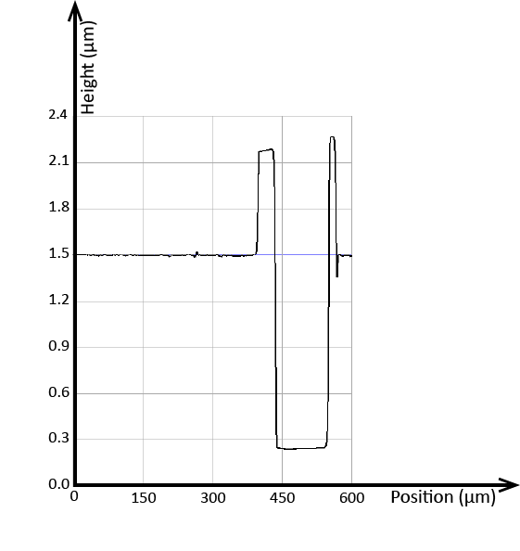
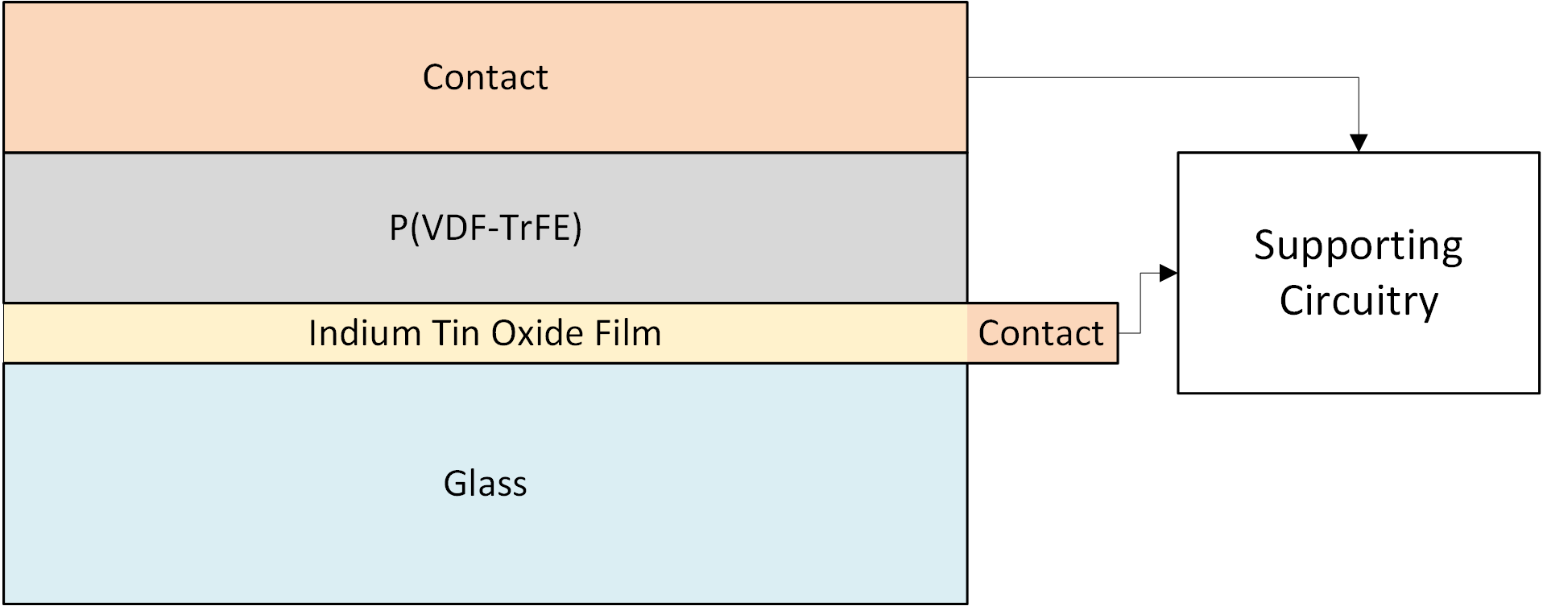
Polymer Specimens
P(VDF-TrFE)
Spin coating
1.2 micron thickness
ITO substrate
Pinholing shorts ITO to top electrode
Process being refined
Notes:
Trent
Weight fractions were chosen to yield the desired thickness when spin coating, while not being too viscous to apply via pipettes.
Solvent was chosen based off of what was utilized in literature.
Solutionizing parameters were determined by values from literature, and the equipment available for use (minimum temperature of 120C on the chosen hotplate)
Cleaning parameters were chosen based off of prior experience with thin film deposition.

Slide 26
Polymer Specimen Troubleshooting
Solvents
Atmospheric conditions
Contacts
Thickness
Currently in contact with a group which creates PVDF films at Nebraska
Purchasing commercial polymer films to test concepts
Notes:
Trent
DMF and NMP
Air, dry nitrogen
Silver paint, silver epoxy, thermally evaporated aluminum, carbon tape.

Slide 27
Barium Titanate Multi-layer Capacitors
Backup if high risk organic materials do not work
Confirm functionality of harvesting circuit
Well documented in literature
Preliminary testing of BaTiO₃ MLCs show high breakdown resistance
Notes:
Trent

Slide 28
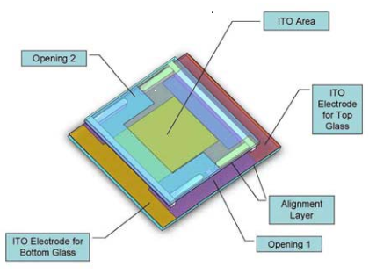
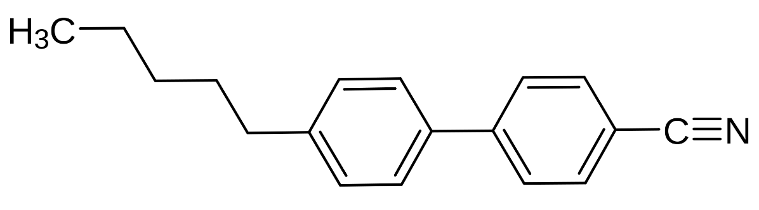
Liquid Crystal Specimens
Commercial cells
5CB liquid crystal
Increasing polarization with electric field
Frequency tuning
Instec Inc. Type SA and SB Liquid Crystal Cell
Structure of 5CB Liquid Crystal
Notes:
Tommy
Commercial liquid crystal cells have several advantages:
Cell design ensures a contact area of 100 mm² and a thickness of 5 microns.
Cell thickness is uniform to within ±0.2 μm. Area is similarly accurate
Can be purchased in a specific alignment, in our case homeotropic (liquid crystals are aligned along the cell thickness).
The liquid crystal is ~1-2 nm in length. This means that they are about 1/5000 of the size of the cell

Slide 29
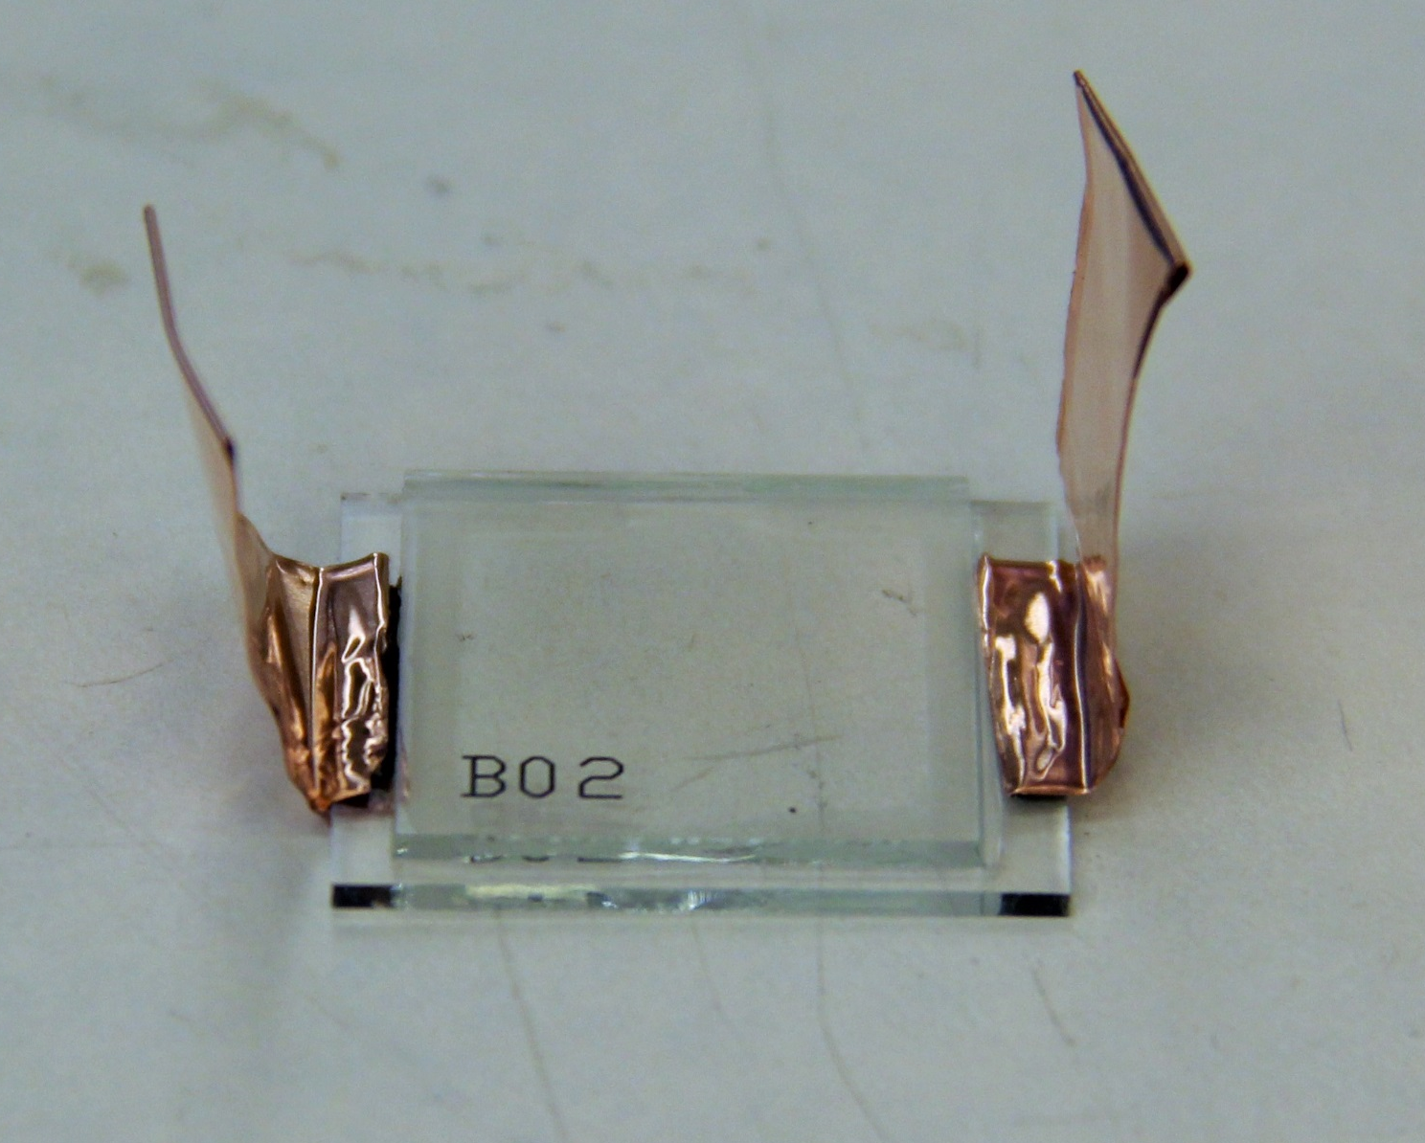
Liquid Crystal Specimens
Notes:
Tommy
Leads are attached using copper wires and silver epoxy. This is what our cell looks like, and what we will pass around the room.
The sample being passed around differs slightly in that there is carbon tape connecting the copper tape. This was done for mechanical reasons
If asked:
Dirty appearance is from residual oil collecting dust.

Slide 30
Liquid Crystal Troubleshooting
Applying 210V results in breakdown preventing the voltage from rising above 150V in the future
400V breakdown observed by other groups
Solutions investigated
  New liquid crystals (hygroscopic)
  Other liquid crystals (longer chain length)
  External contacts (prevent conduction)
  Increase temperature (phase change)
Notes:
Tommy
Hygroscopic behavior did not significantly effect the breakdown temperature.
The longer chain length caused a higher breakdown voltage, but breakdown was more rapid, and complete
External contacts were not pursued as it would make calculation of capacitance far too complicated
Increasing temperature did not reverse the effect.
The final solution we decided on, was to run the material at a lower applied field than 400V. The material was run at 150V to 50V instead of the desired 100V-400V

Slide 31
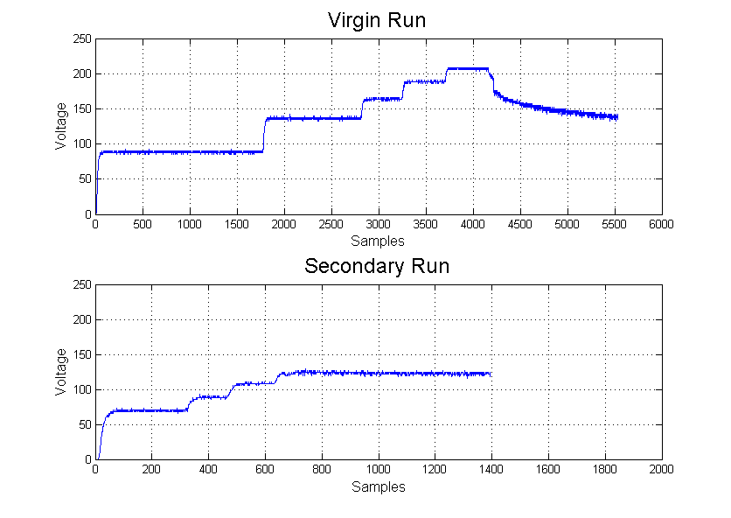
Liquid Crystal Troubleshooting
Notes:
Tommy

Slide 32
Characterization: Sawyer-Tower
The values of the resistors and capacitor will be modified to match the various pyroelectric samples.
Notes:
Josh
Used to characterize pyroelectric material.
Resistor voltage
Voltage on pyroelectric sample
Step-down from high voltage
Similar to power systems
Capacitor voltage
Charge Displacement
V=q/C
Capacitors in parallel – displacement will be the same on both

Slide 33
Harvester: Switch-level Model
Notes:
Josh
Switch positions are shown for the various stages of the cycle.
1->2 the voltage is being ramped up
2->3 maintaining high voltage and heating up specimen
3->4 disconnecting voltage source and connecting to load
4->1 after harvesting the low voltage is applied and the material is brought back into its original state

Slide 34
Harvesting Circuit
Notes:
John
Ok, here I have pictured our harvesting and control circuit.
Pending characterization of pyroelectric elements using the Sawyer Tower circuit, we will set up a microcontroller to drive the PE device through the Olsen Cycle.
1) Microcontroller monitors system
2) Turns on optoisolator when time to close the switch
- Motivation for optoisolators: Electrical isolation of microcontroller (LV) and MOSFET (HV) to prevent damage.
3) Optoisolator connects high gate voltage to MOSFET
4) Measure voltage on the harvesting load to determine power generated
DONE
Fairchild Semiconductor High Voltage Phototransistor Optocouplers – MOC8204M
400V maximum
Add in series

Slide 35
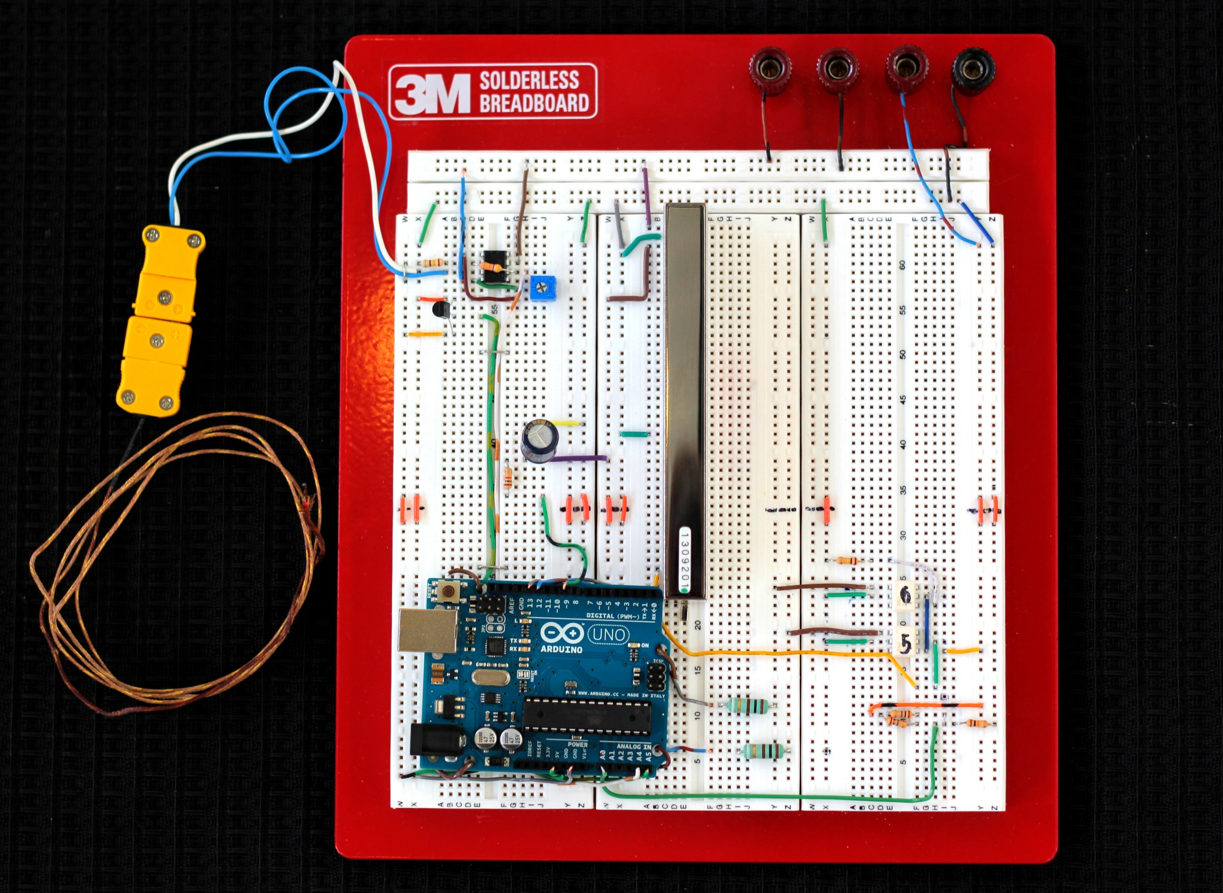
Notes:
John
This is a picture of the previous circuit design implemented on a breadboard

Slide 36
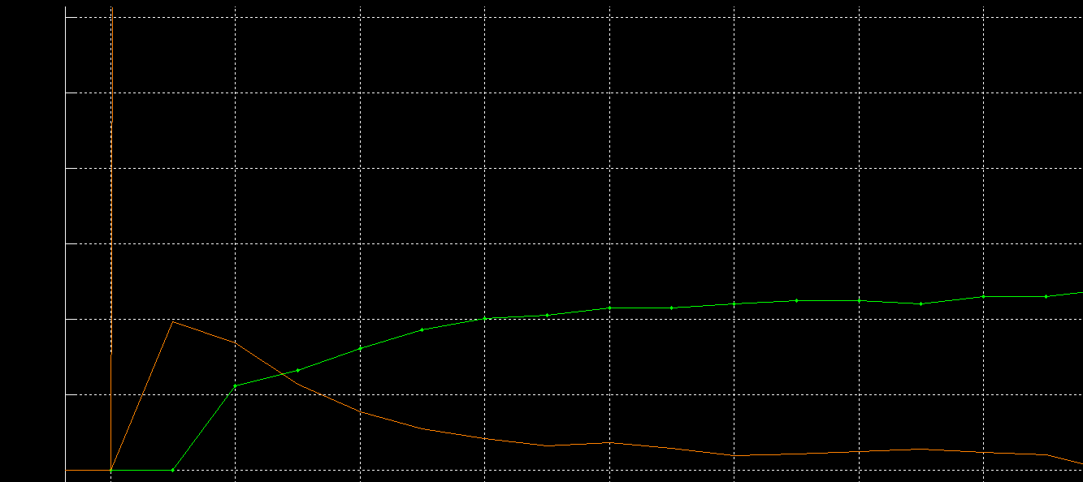
Results
Device Characteristics
Voltage
Current
Notes:
John?

Slide 37
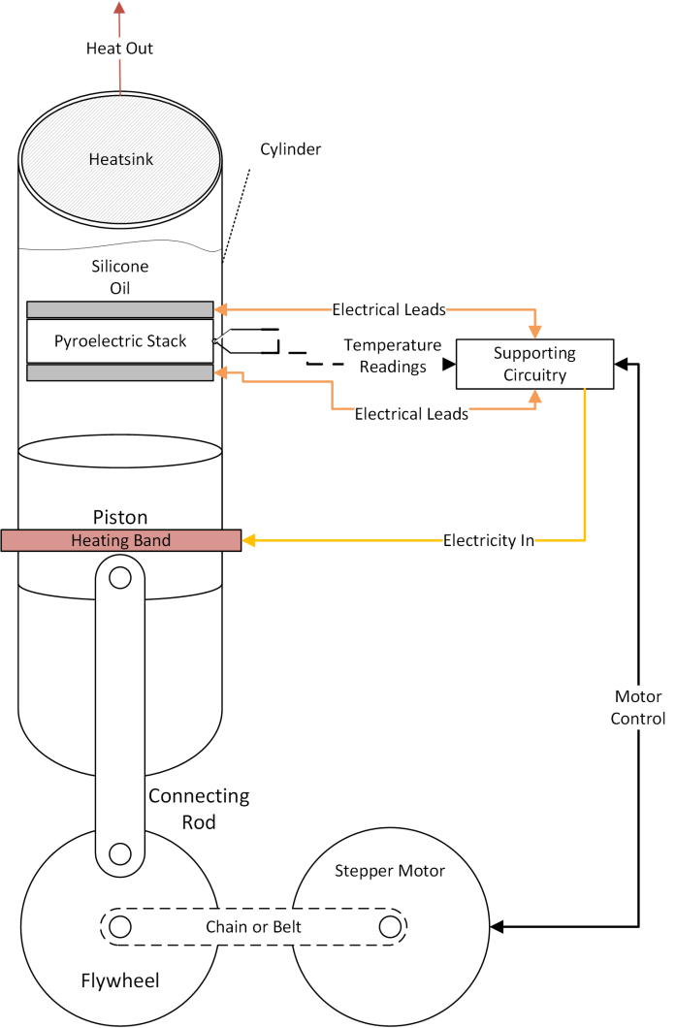
Future Work - Concept Sketch
The device consists of three subsystems:
Mechanical/Heat Transfer – Piston, stepper motor, silicone oil, heat sink, heating band.
Material – Pyroelectric material and contacts.
Electrical – Thermocouples, harvesting circuit, switching circuit, and motor controller.
Notes:
John
Silicone oil – Used to electrically insulate the pyroelectric stack and transfer heat
Heat sink – removes heat from oil for cooling
Heating band – ohmic heater for providing heat, will be a source of waste heat in real world applications
Piston – moves fluid between heating and cooling elements
Stepper motor – accurately controls position of piston
Pyroelectric material – liquid crystals, ferroelectric polymer, or ceramic nanosheet colloid with appropriate contacts
Thermocouples - monitor temperature of the element
Supporting circuit – apply appropriate electric fields, harvests electricity, and control stepper motor.

Slide 38
Conclusion
Electrical characterization has preliminary results, but is an ongoing project
Preliminary circuits designed
Heat transfer system will be explored later
Notes:
John
This concludes our presentation. We will now gladly open the discussion to your questions.

Slide 39
Acknowledgements
We would like to thank Scott Beckman and Sumit Chaudry for their role as our advisors
We would like to thank our client Pete Onsted for his generous donation to foster collaboration between materials science and electrical engineering
Notes:
John

Slide 40
Additional Information

Slide 41
Safety
High voltages
  Lockout tag out
  Insulating gloves
Temperatures
  Heat resistant gloves
  Oil resistant clothing
  Safety goggles
Chemicals
  Chemical resistant gloves
  Storage and disposal plan
  Fume hood
  Safety goggles

Slide 42
Cost Analysis – Liquid Crystals
Supplier | Name | Unit | Quantity | Price | Subtotal
Sigma Aldrich | 4’-Pentyl-4biphenylcarbonitrile | Gram | 1 | $ 72.30 | $ 72.30
Sigma Aldrich | 4’-Hexyl-4biphenylcarbonitrile | Gram | 1 | $ 90.20 | $ 90.20
Sigma Aldrich | 4’-Octyl-4biphenylcarbonitrile | Gram | 1 | $ 84.80 | $ 84.80
Instec Inc. | Homeotropic alignment LC cells | Holders | 20 | $ 14.00 | $ 280.00
 |  |  |  | Total | $ 527.30

Slide 43
Cost Analysis – Polymer
Supplier | Name | Unit | Quantity | Price | Subtotal
Delta Technologies | ITO coated glass slides | Piece | 20 | $ 8.00 | $ 160.00
Piezotech | PVDF-TrFE 70/30 | Gram | 2 | $ 10.00 | $ 20.00
Sigma Aldrich | N,N-Dimethylformamide | Liter | 1 | $ 85.40 | $ 85.40
Fisher Scientific | 1oz/30mL Polypropylene Bottles | 12ct Pack | 2 | $ 12.53 | $ 25.06
 |  |  |  | Total | $ 290.46

Slide 44
Cost Analysis – Lab Supplies
Supplier | Name | Unit | Quantity | Price | Subtotal
Fisher Scientific | Acetone (Certified ACS) | 4L Bottle | 1 | $ 22.06 | $ 22.06
Fisher Scientific | Methanol (Certified ACS) | 4L Bottle | 1 | $ 16.12 | $ 16.12
Fisher Scientific | Best Butyl II Gloves | Pair | 1 | $ 50.47 | $ 50.47
Fisher Scientific | 4.4 x 8.4 Lint Free Wipers | 280ct Box | 2 | $ 3.82 | $ 7.64
Fisher Scientific | Cotton-Tipped Wooden Applicators | 1000ct Pack | 1 | $ 7.71 | $ 7.71
Fisher Scientific | Graduated Disposable Pipettes | 500ct Box | 1 | $ 14.29 | $ 14.29

Slide 45
Cost Analysis – Lab Supplies
Supplier | Name | Unit | Quantity | Price | Subtotal
Chem Stores | Disposable Nitrile Gloves 50pr/box | Box | 2 | $ 6.04 | $ 12.08
Ted Pella Inc. | Carbon Conductive Sheet | Pack/10 | 1 | $ 39.75 | $ 39.75
Ted Pella Inc. | Copper Conductive Tape | Roll | 1 | $ 41.25 | $ 41.25
Ted Pella Inc. | Double Sided Kapton Tape | Roll | 1 | $ 52.10 | $ 52.10
Ted Pella Inc. | PELCO Water Based Carbon Paint | 50g Bottle | 1 | $ 9.95 | $ 9.95
Ted Pella Inc. | PELCO Colloidal Silver Paste | 25g Bottle | 1 | $ 59.50 | $ 59.50
 |  |  |  | TOTAL | $ 332.92

Slide 46
Cost Analysis - Electrical
Supplier | Name | Unit | Quantity | Price | Total
Sparkfun | Arduino Uno | Board | 1 | $ 29.95 | $ 29.95
Digkey | 35V - 1uF - MLC - X7R | Capacitor | 5 | $ 0.23 | $ 1.13
Digikey | DC/DC 1kV converter | Unit | 1 | $ 189.02 | $ 189.02
Digikey | Transistor Optocoupler | 6-DIP | 10 | $ 0.94 | $ 9.40
Digikey | 3 Row solderless BB | Board | 1 | $ 122.04 | $ 122.04
Digikey | Temperature Sensor | Unit | 3 | $ 1.42 | $ 4.26
Digikey | K-type Temperature Probe | Unit | 3 | $ 14.95 | $ 44.85
Digikey | K-type Thermocouple female sockets | Unit | 3 | $ 7.10 | $ 21.30
Digikey | AC/DC wall pack | Unit | 1 | $ 4.68 | $ 4.68
TOTAL | $ 426.63

Slide 47
Adiabatic Electrocaloric Effect
Pyroelectric Coefficient

Slide 48
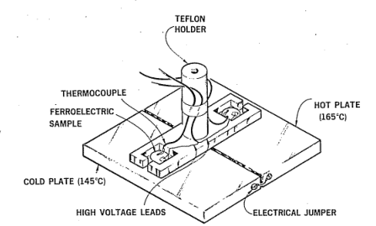
Manual Heat Transfer System
Manual rotation between cold and hot plates.
Figure from Olsen Journal of Energy (1982)
Notes:
We will use a similar method for our initial heat transfer system, moving our sample between a hot plate and a cold plate or heat sink.

Slide 49
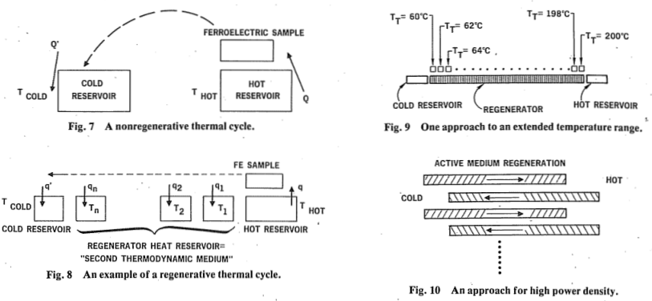
Regenerative Heat Transfer System
Utilize a series of materials with a gradient of transition temperatures to maximize efficiency
Figure from Olsen Journal of Energy (1982)
Notes:
The range of transformation temperatures may be accomplished through the mixing of liquid crystals with different transition temperatures

Slide 50
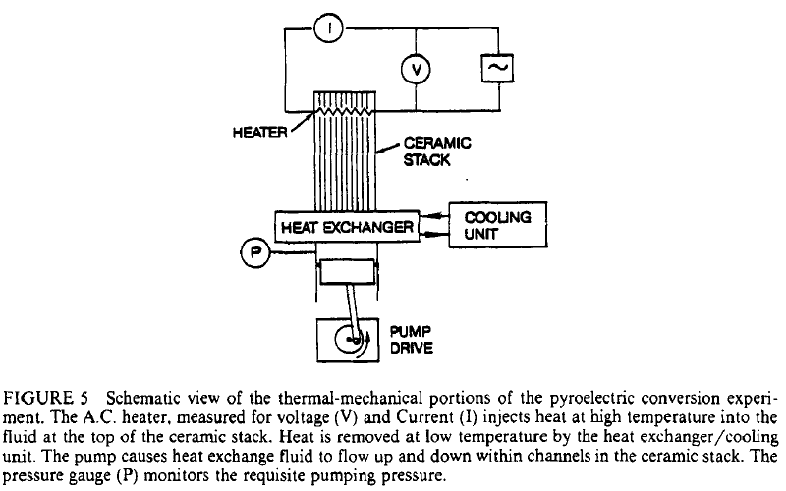
Automated Heat Transfer System
Figure from Olsen, Bruno, Briscoe, Dullea Ferroelectrics (1984)
Notes:
An automated piston driven by a motor is utilized to control the application and removal of heat from the pyroelectric materials.
While we can fabricate such a design, optimization of its efficiency requires fluid dynamics and heat transfer calculations beyond the scope of Mat E and EE curriculum.

Slide 51
Polymer Spin Coating
3-4 drops of solution.
5 wt% at 750-1250 rpm for 30-45s.
10 wt% at 2000-3000 rpm for 30s, and 750 rpm for 60s.
10 wt% at 3000 rpm for 30s has uniform 1.2 micron thickness.
Annealed for 30m at 80°C
Notes:
750 rpm and 30 seconds was determined from literature. Based off of the appearance of the first film from each solution, further parameters were tried.
Annealing parameters came from literature, serves to remove DMF solvent leaving just a polymer film.
In the case of the 10 wt% film which was spin coated for 60 seconds at 750rpm, after 30 seconds there was minimal spreading due to the viscosity, so it was spun again for 30 more seconds.

Slide 52
Preliminary Polymer Characterization
Notes:
There is no evidence of typical polarization vs electric field behavior (straight line or hysteresis loop), nor were negative voltages applied by the software running the test.

Slide 53
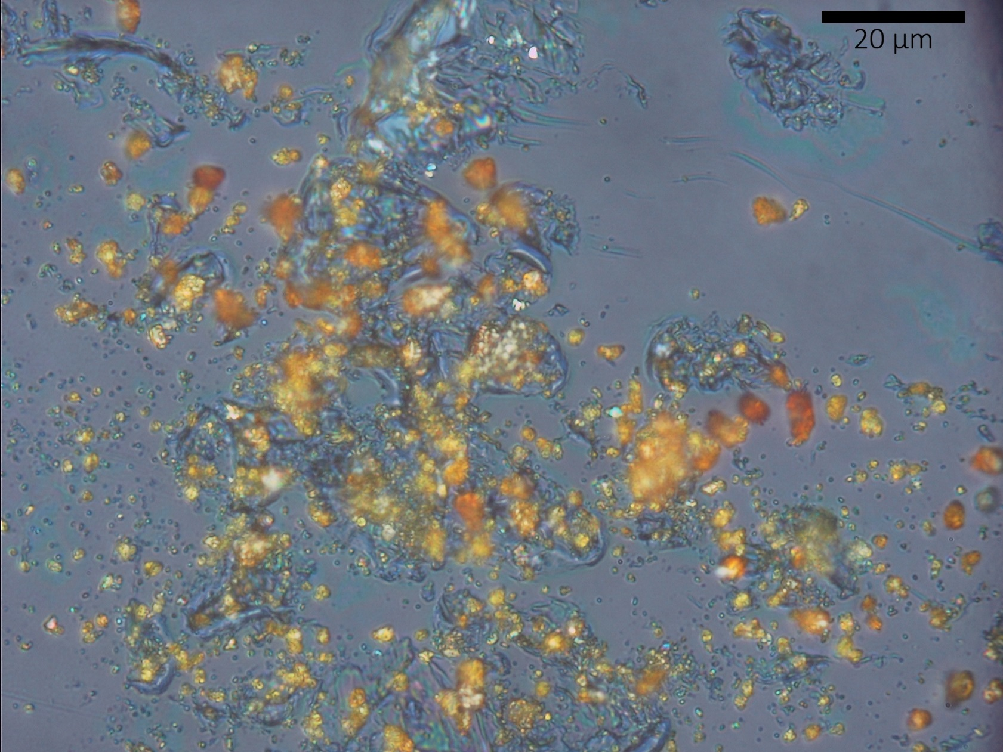
Polymer Micrographs
Presence of pinholes and photoresist.

Slide 54
Liquid Crystal Material
Nematic liquid crystals were chosen due to their significant entropy change.
4'-Pentyl-4-biphenylcarbonitrile (5CB) was chosen due to literature on electrocaloric effect.
4’-Hexyl-4biphenylcarbonitrile, and
4’-Octyl-4biphenylcarbonitrile were also purchased for their higher transition temperature.
Structure of 5CB Liquid Crystal
Notes:
The three liquid crystals are the same except for chain lengths of 5, 6, and 8 respectively on the left side of the figure.
As a result of increased length, the entropy change from the phase transformation from nematic to isotropic, as well as the transition temperature both increase.
By mixing them together, it may be possible to expand the temperature range of the phase transformation.

Slide 55
Preliminary Liquid Crystal Characterization
Shows increasing polarization with increasing field as expected.
Max polarization should occur at max field.
Notes:
There is evidence of increasing polarization with increasing electric field.
Maximum polarization occurs as electric field begins to decrease, possibility that the LC polarization rate and AC frequency are mismatched.
There is also further room to continue increasing the electric field (by approximately 60%)

Slide 56
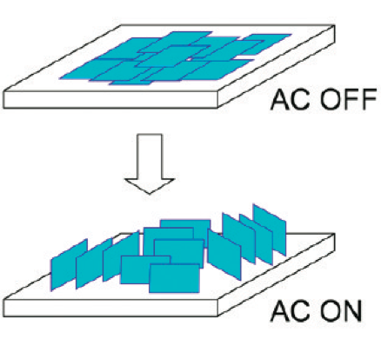
Ceramic Nanosheets
Liquid crystal holders
Preliminary characterization in progress
Nakato et al.
Journal of Physical Chemistry C (2011)
Notes:
Not all materials are in all solvents

Slide 57
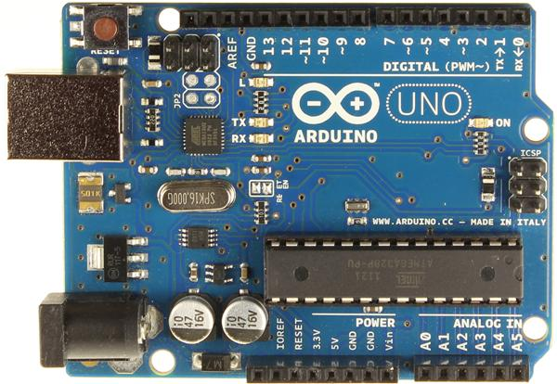
Microcontroller
Isolator Trigger & Stepper Control
Arduino Uno
  Meets our specification
  Low cost
  Large user community, base code
  Compatible with our stepper motor and driver
Thermocouples

Slide 58
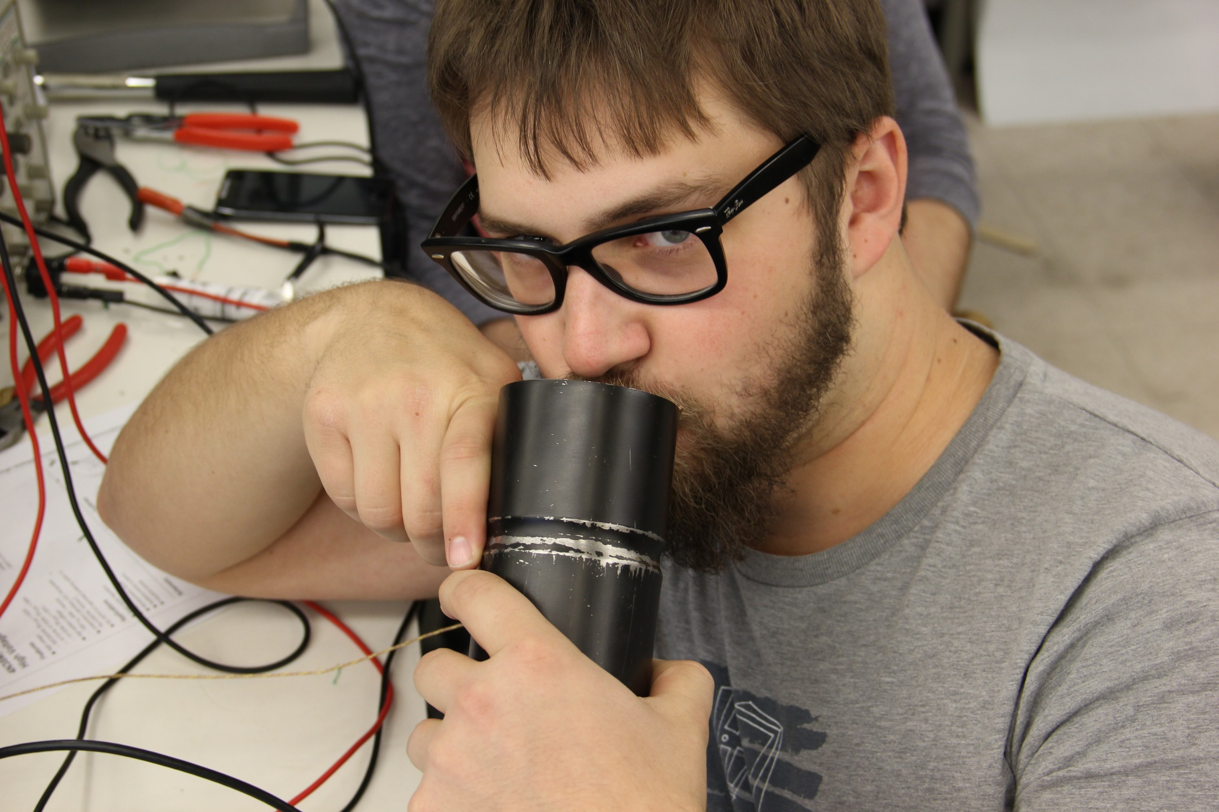
Thermocouple Testing

