Slide 1
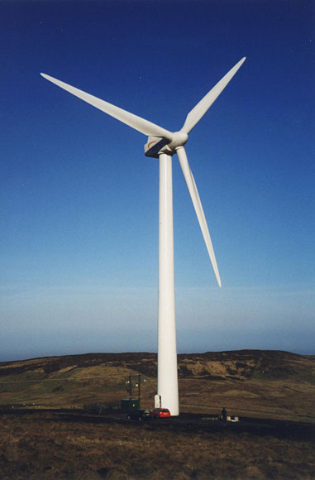
Development of Laboratory Module for a Small Wind Turbine System (Phase V)
Team members: Adam Literski, Achila Jayasuriya, Eurydice Ulysses, Josephine Namatovu, Logeshwar Sampathkumar, Liaochao Song
Client / Advisor: Dr. Venkataramana Ajjarapu
MAY1329
Slide 1 of 13

Slide 2
Project Goals
Develop a small wind turbine system in a laboratory environment
Serve as an educational tool for independent or class purposes
Use Digital implementation of power electronics using simulations on
MATLAB ASMG and
Code Composer Studio
MAY1329
Slide 2 of 13

Slide 3
Project Deliverables
Project documentation user manual
Step-by-step operation instructions
In-depth schematics and wiring diagrams
Final Project Plan & Design Document
MAY1329
Slide 3 of 13

Slide 4
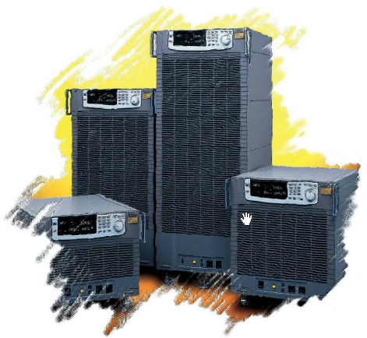
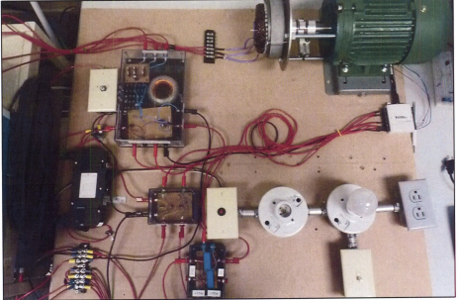
Phase IV System
Old system:
Induction motor has 1.5 Hp
Motor frequency controlled with a Variable
Frequency Drive
NIDAQ Control Source
NI LabVIEW user interface
Issues:
Buck boost IGBT burning out
System functioning not complete
Figure 1:
Variable Frequency Drive
Figure 2:
Phase IV System
MAY1329
Slide 4 of 13

Slide 5
Current System
Old system:
New motor run by TI drive kit
TI Control Suite user interface
Revised buck boost converter
Arduino for voltage comparison
Voltage sensors in the system
Picture of Entire System!!!
Figure 3:
Phase V System
MAY1329
Slide 5 of 13

Slide 6
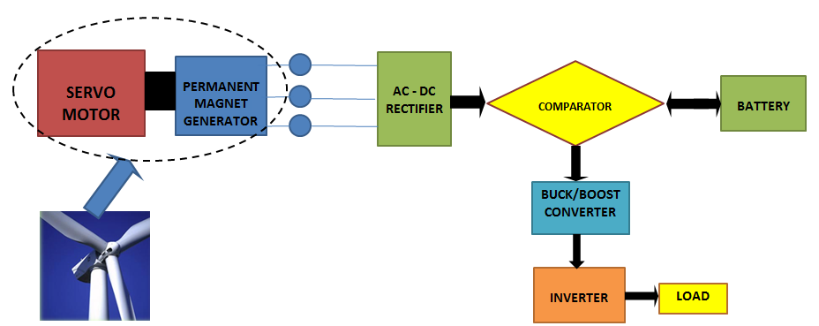
Overall System
Figure 4: Overall System
MAY1329
Slide 6 of 13

Slide 7
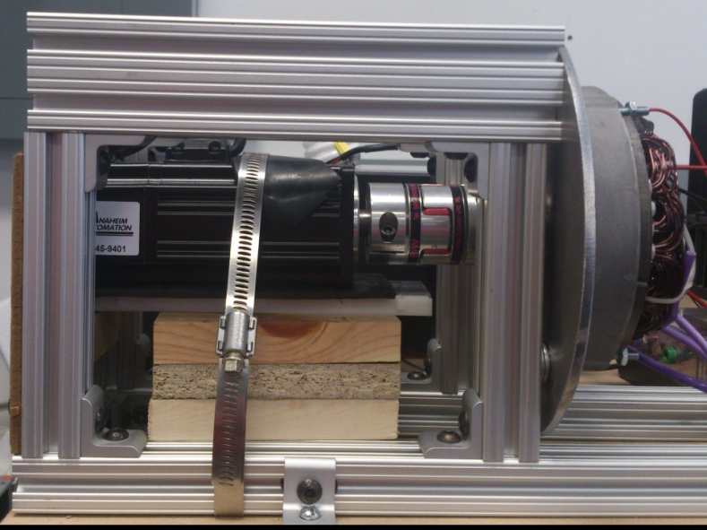
Motor And Generator
Insert GUI of the Motor
Signal sent from the TI kit to run the motor
Figure 5: TMDSHVMTRPFCKIT
Figure 6: EMJ-04APB22 Motor coupled
with Permanent Magnet Generator
MAY1329
Slide 7 of 13

Slide 8
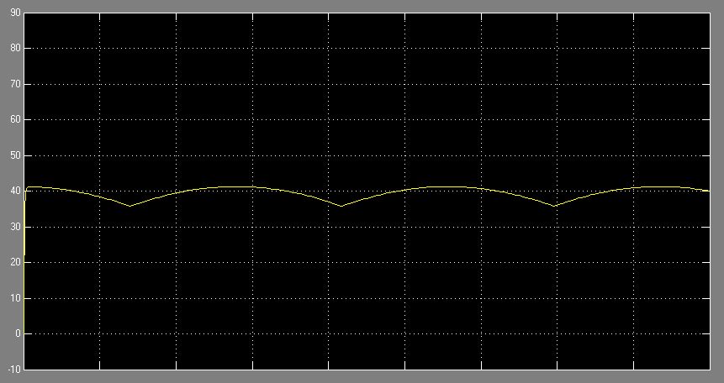
Three – Phase Rectifier
Figure 4: Rectifier Simulation Output
Calculation
$$Vdc\left(max\right)=\frac{3\sqrt{3}∗Vpeak}{π}∗cosα= \frac{3\sqrt{3}∗\sqrt{2}∗17}{π}∗1=40V$$
Figure 7: Three-Phase Rectifier in ASMG
MAY1329
Slide 8 of 13

Slide 9
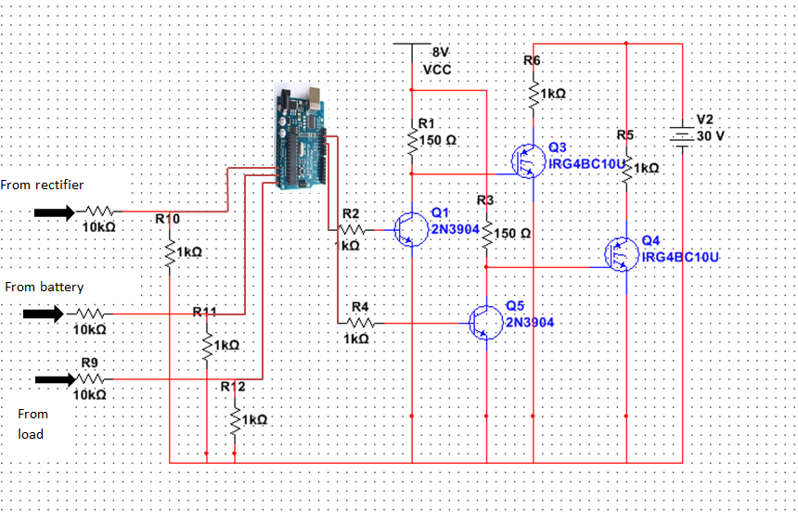
Voltage Comparator
Figure 8: Comparator schematic
Slide 9 of 13

Slide 10
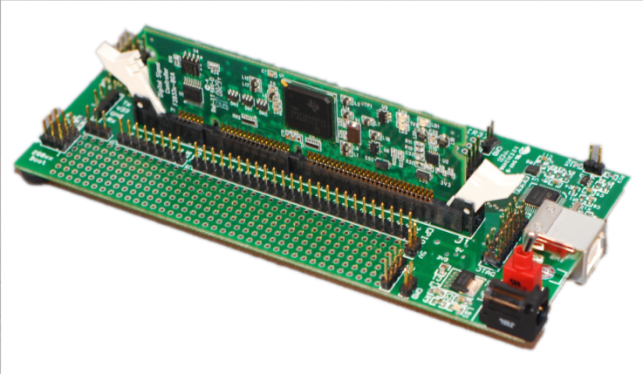
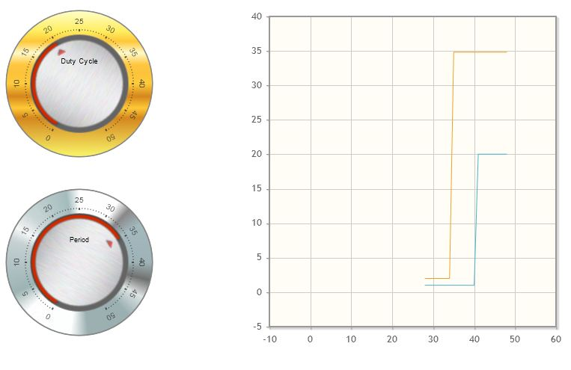
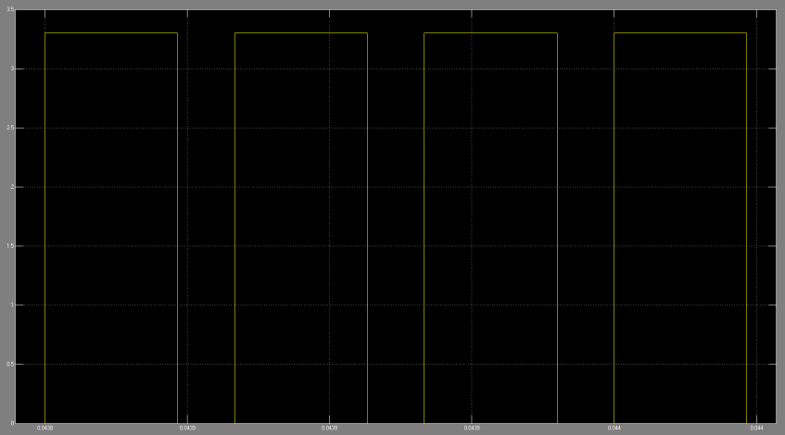
Pulse Width Modulation
Using a ControlCARD, the duty cycle of the Buck /Boost converter is easily monitored
Figure 9: ControlCARD
Figure 10: Pulse Width Modulated Signal
Figure 11: Graphical User Interface
MAY1329
Slide 10 of 13

Slide 11
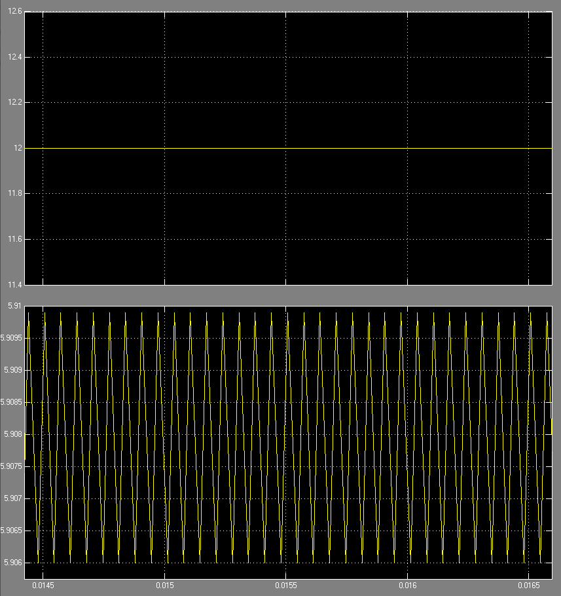
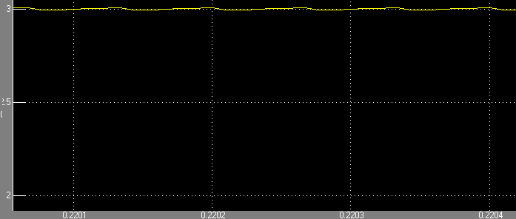
Buck / Boost Converter
Figure 12: Buck/Boost schematic &
simulation results
Input voltage = 12V
Depending on Duty Cycle Variable output
Duty cycle = 20% (buck system)
Duty cycle = 70% (boost system)
Slide 11 of 13

Slide 12
Test Plan
Test system stability for various input voltages
Test system for a standard runtime
Battery backup implementation
Address three cases:
Power Generation > Load
Power Generation = Load
Power Generation < Load
Dissipate excess power generation
MAY1329
Slide 12 of 13

Slide 13
Challenges Encountered And Solutions
Challenges:
Unavailability of Variable Frequency Drive
Relevant knowledge base
Discrepancy in old schematics
Solutions:
Motor replacement
Relevant knowledge base from EE 452 (Power Electronics & Drives) labs
Revision of the old system
MAY1329
Slide 13 of 13

Slide 14
Demo
INSERT VIDEO HERE!!

Slide 15
Questions
May 1329: Development of a Small Wind Turbine System
Client / Advisor: Dr. Venkataramana Ajjarapu

