Slide 1
Customer Loyalty Program for Small Businesses
Team members: Van Nguyen, Christopher Waters, and William Tran
Client: iapp24
Advisor: Govindarasu

Slide 2
Problem Statement
Punch Cards are easy to lose and no one likes carrying coupons around
Hard for small businesses to systematically gauge loyalty of customers
Current loyalty applications are not widely used
Team May 13-23
Client: iapp24
Advisor: Govindarasu
Notes:
Chris

Slide 3
Conceptual Sketch
Notes:
Chris

Slide 4
Functional Requirements
The system shall allow the user to login and logout.
The system shall allow the user to create an account
The system shall allow merchants to create loyalty cards
The system shall allow merchants to expire existing loyalty cards
The system shall allow merchants to verify customer punches
The system shall allow merchants to verify customer rewards
The system shall allow customers to search for local businesses
The system shall allow customers to select loyalty cards
The system shall allow customers to download loyalty cards
The system shall allow customers to redeem punches
The system shall allow customers to redeem rewards
The system shall allow the database to store a history of completed punch cards
The system shall allow the merchant to view card history for their business
The system shall allow the customer to view personal card history for completed rewards
Notes:
Van

Slide 5
Non-functional Requirements
The system shall be developed using the Appcelerator SDK
The system shall use an encrypted SQLite database for local storage to prevent other applications from interacting with a user’s card data
The system shall utilize hashing verification for punch and reward verification
Notes:
Van

Slide 6
Technical/Other Constraints/Considerations
Implementing a Cloud Solution
New phone
Loss of data
Verification of QRCodes
private/public key
hashing
GPS
Notes:
Will

Slide 7
Feasibility
Skills
Our team has the programming knowledge and experience to create this application
We are able to learn new technologies needed
Market
We are developing this application for a Des Moines based company
Currently no application that dominates the market for this type of application
Unique leveling feature & hybrid local/cloud capabilities.
Notes:
Chris

Slide 8
Potential Risk Mitigation
Risk | Mitigation
R1. Losing a team member | We will contact our advisor.
R2. Limited experience of Appcelerator | We will begin learning the Appcelerator framework as early as possible
R3. None of us have a mac to do IOS development. | We will use macs on campus for development.
R4. The schedule planned might not be realistic, because of R2. | We will begin implementation as modules are designed.
Team May 13-23
Client: iapp24
Advisor: Govindarasu
Notes:
Will

Slide 9
Resource/Cost Estimate
Items | Cost
Amazon Web Server | $0
Appcelerator SDK | $0
Mysql server | $0
Android | $0
Android phone for testing | $0
Ipod touch | $0
Apple Developer Kit | Provided by Client
Notes:
Will

Slide 10
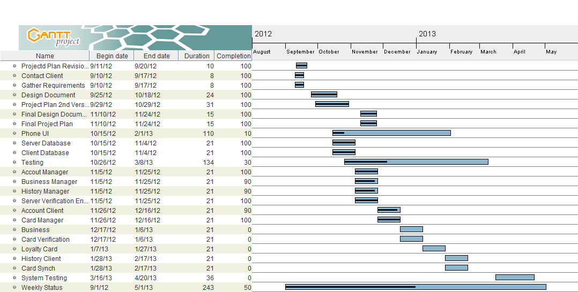
Schedule
Notes:
Will

Slide 11
System Block Diagram
Notes:
will

Slide 12
Server side modules
Account Manager
User Login
Account creation
Resetting password
Encryption Verification
Hashing a users password
Generating a QR Code
Notes:
will

Slide 13
Server side module Cont.
Card Manager
Create and store loyalty card templates
Retrieve loyalty card templates
History manager
Add card
Update card
Retrieve specific card history
View downloaded card history
Notes:
Van

Slide 14
Server side modules contined...
Business Manager
Create and link up business to user
Have Verification module create QR
Email QR to user
Retrieve businesses for a user
Handle searching of businesses based on
Name, gps, ... etc
Update Business Info
Notes:
Will

Slide 15
Client Modules
Cloud Sync
Update server with local info
Check for unsynchronized data
Client Reward verification
Scan and Verify QR Code
check for match with card's hash
Notes:
Will

Slide 16
Client modules Cont...
Loyalty Card
Download Card From server
Handle card punches (Calls Verification)
Handle change in state of card
Retrieve all current loyalty cards
Retrieve all completed loyalty cards

Slide 17
Client modules Cont...
Account
Handle login sessions
Interact with Server Account Manager
Business and History
Setting up connection to interact with Business and History manager
Team May 13-23
Client: iapp24
Advisor: Govindarasu

Slide 18
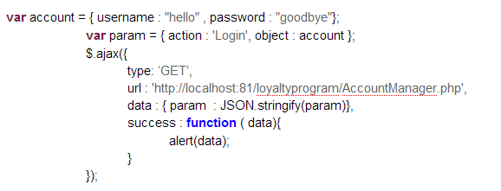
Interface between client and server
Notes:
Will

Slide 19
MVP software pattern
View interacts with controller.
Presenter holds all of the logic.
Example - User needs to download a card
Notes:
Chris

Slide 20
Server Side Schema
Notes:
Will

Slide 21
Client Side Schema
Use of local database to hold user's cards.
Card_metadata hold card template.
Will be synced up with server side database for cloud functionality.
Notes:
Van

Slide 22
Prototypes
Login and create account
Notes:
Van

Slide 23
Prototypes
Setting and Business view
Notes:
Van

Slide 24
Prototypes
Create loyalty cards
Notes:
Van

Slide 25
Prototypes
Collect and Redeem
Notes:
Van

Slide 26
Hw/sw Technology platforms used
Languages : Javascript, Php,MySQL, SQLLite
SDK: Appcelerator
Libraries : PHPQRCode, PHPMailer
Server : Amazon Ec2, Apache
Targeted Phone Platforms: IOS, Android
Notes:
Will

Slide 27
Testing Plan
Unit Testing (White Box)
Use case scenario for system testing
UI Testing - manual
Notes:
Chris

Slide 28
Prototype implementation
<Demo>
Notes:
Chris

Slide 29
Current project status w/ respect to milestones
Completion of Document
Implementation of Server Code
Deployment of servers
UI Prototype Designed
Notes:
Will

Slide 30
Task Responsibility/Contributions of each member
Will
Task planning
Server design/implementation
Van
Create, design, and manage team website
Server implementation
Chris
UI Design/Implementation
Client Communication
Notes:
Van

Slide 31
Plan for next semester
User Interface implementation
Client side module implementation
System Testing
Notes:
Chris

Slide 32
Questions

