Slide 1
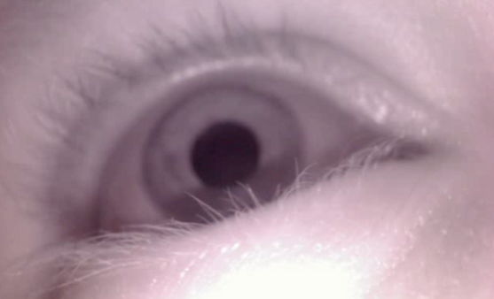
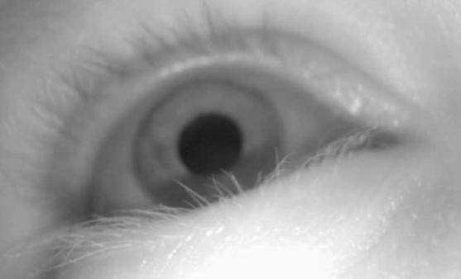
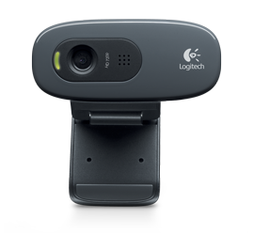
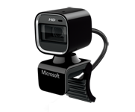
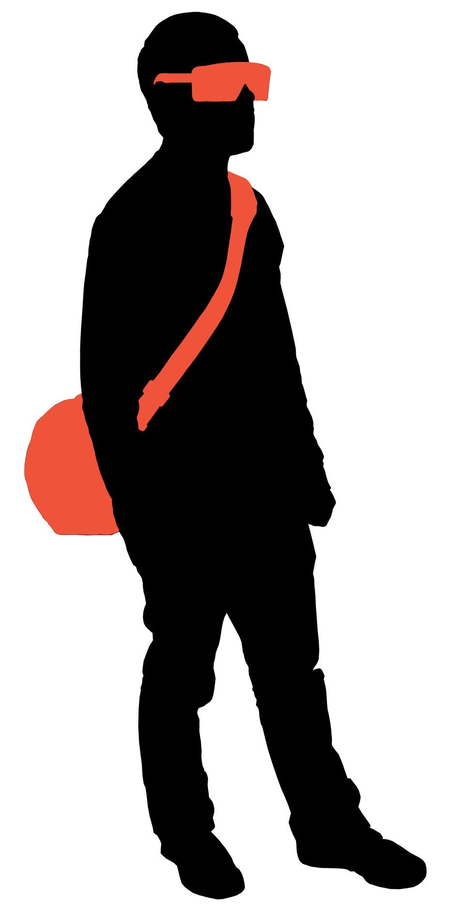
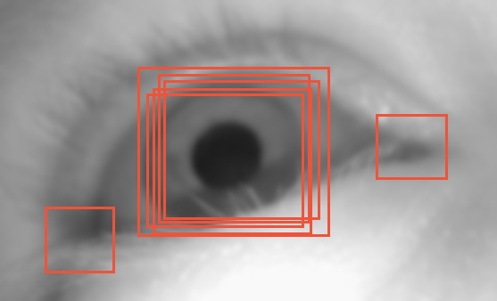
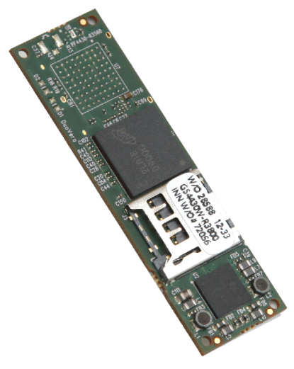
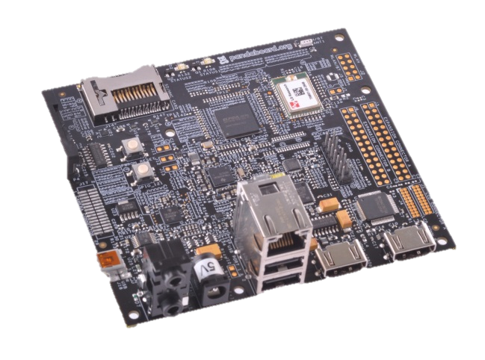
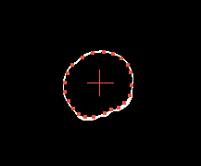
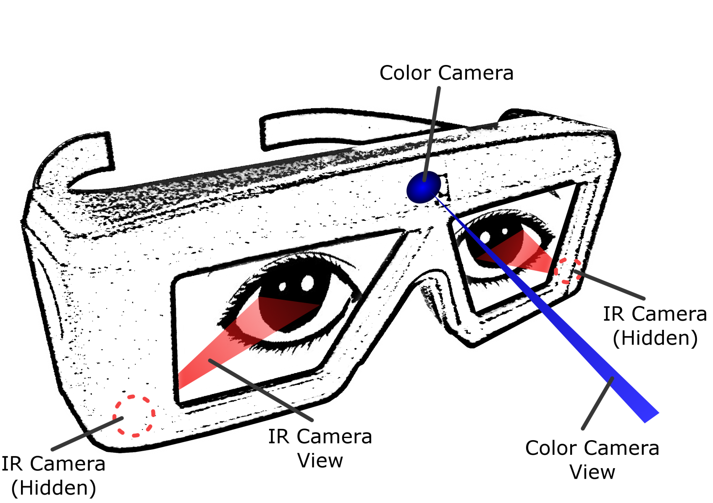
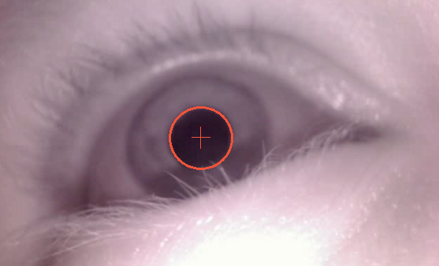
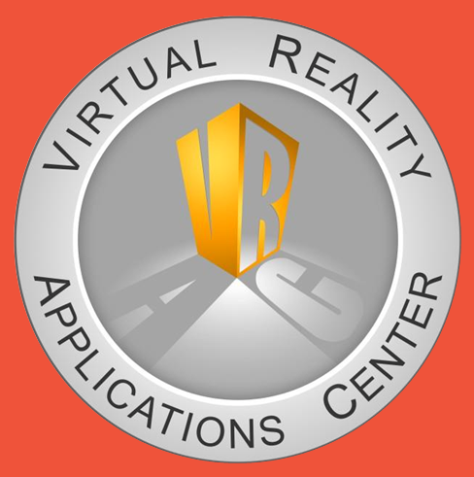
Mobile Stereoscopic Eye Tracking
Iowa State University ECpE Senior Design Team May 13-20
Justin Derby, Kristoffer Scott, Tyler Burnham, Arjay Vander Velden, Will Bryan, Scott Connell
Advisor: Daji Qiao
Client: Stephen Gilbert, VRAC
Introduction
Project Eyeris is an embedded, mobile, real-time eye tracking system. The goal of this project is to create a viable solution to handle 3D environments as well as real-time video streaming to observers. There is no current product that handles both of these requirements. Our solution is primarily to be used for virtual reality applications at Iowa State’s Virtual Reality Application Center. Project Eyeris is the work of a six member team including an Electrical Engineer, Software Engineers and Computer Engineers over the course of two full semesters.
Design Requirements
Track both eyes with minimal error (less than 1.5 degrees)
Can be used with active stereo shutter glasses.
All data and outward-facing video collected from the glasses shall be transmitted wirelessly and will be able to be viewed in real time
No more than 10 second delay
Unobtrusive and non-invasive
Glasses: no more than 2 pounds and no wider than 10 inches
Backpack: no more than 5 pounds
Viewer's environment: 720p color video, field of view of 56 x 40 degrees
Eye tracking: 30 frames per second
Pupil Fitting Algorithm
Grabs a picture from the
inward-facing webcam
Workflow/Components
Cameras
Logitech C270
Outward-facing camera records what the user is looking at.
Microsoft HD 6000
Inward-facing IR cameras to capture the motion of each eye.
Grayscale the picture
Algorithm Board
Use Haar-like feature detection to find the general area of the pupil (which is a dark area surrounded by a light area)
Gumstix DuoVero
The cameras are connected to an embedded board that runs an ellipse-fitting algorithm, which converts an image of an eye into data useful for the eye-tracking algorithm on the server. This data is sent over the serial port to the main board.
Threshold the image to get the general area of the pupil. The center weight of the black area is the center of the pupil
Main Board
Technical Details
Programming languages used:
C/C++
Libraries used:
Boost
OpenCV
Intel Threaded Building Blocks
GStreamer
Qt Framework
Development tools used:
Netbeans C/C++
Qemu
Qt Creator
Environments used:
Ubuntu (GNU/Linux)
Pandaboard ES
The main embedded board combines the outward-facing camera and the eye data and streams it over Wifi to the server.
Manipulate the image to get rid of eye lashes, etc., and do
edge-detection on the pupil
Server
Find points from the center to the edges and perform an
ellipse-fitting algorithm
VRAC Cluster
The server analyzes the data from both eyes, and computes the direction and depth of where the user is looking. The server then overlays this information on the outward-facing video, and streams it to all connected clients.
Glasses Mockup
Clients
The ellipse has been found
and used for any other calculations
(e.g. gaze, distance)
Observers
The clients receive the video from the server with the painted point of focus from the outward-facing camera. They can also send control messages to fine-tune the algorithms.
Active Stereo Shutter Glasses
Testing
Testing was done on local machines, and also on the hardware for the project
We have tested our software using integration testing, and system testing. Independent modules were tested as a single unit, then tested as a whole with many other modules.

