Slide 1
Team May1310
iPod Barcode Scanner
Team Members:
Taylor Bouvin – CPRE
Kok Aun Chee (Kodi) – EE
Anna Grimley – EE
Mike Kinsella – CPRE
Jake Kyro - EE
Advisor:
Professor Wang
Client:
Marshalltown Company

Slide 2
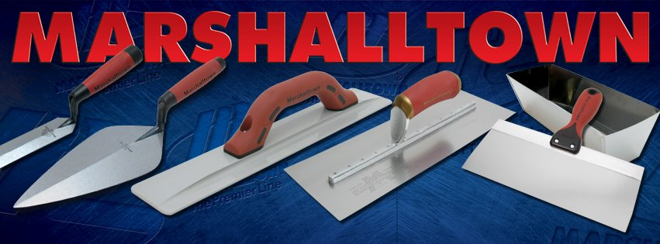
Marshalltown Company
Based in Marshalltown, IA
Known as a leader in American manufacturer of various construction tools, especially trowels
Marshalltown Company has a warehouse in Arkansas where employees are required to scan barcodes
iPod Barcode Scanner
Team May1310
Presenter: Anna
Notes:
Anna

Slide 3
Objective
Our goal is to create an efficient, inexpensive, and portable 1D barcode scanner that utilizes an iPod Touch and an off-the-shelf barcode engine. Current barcode scanners are inefficient or too expensive for Marshalltown Company’s needs. Our focus is to create a user-friendly device that easily integrates into the company’s current inventory system.
iPod Barcode Scanner
Team May1310
Presenter: Anna
Notes:
Anna

Slide 4
Deliverables
A functional design that can easily be implemented and manufactured.
Source code that can be used in conjunction with the current inventory iOS app Marshalltown has created.
A minimum of one working printed circuit board.
iPod Barcode Scanner
Team May1310
Presenter: Anna
Notes:
Deliverables

Slide 5
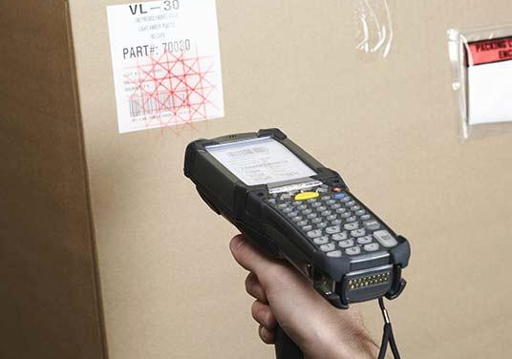
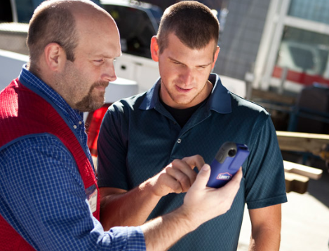
Market Analysis
Current Device
Possible Solution
Current Barcode Scanning device used is over $1000 and has a poor user interface
Lowes Bar Code Scanner over $500 each and includes Credit Card Reader
Camera Apps
iPod Barcode Scanner
Team May1310
Presenter: Anna

Slide 6
Technical Terms Definition
RS232 - A standard used for serial binary data communication.
Barcode Scan Engine - A hardware module that is capable of scanning 1D barcodes and transmitting the corresponding barcode data as serial data (Opticon MDL1000) .
TRRS - A connector with four contacts typically used for analog signals, primarily audio. Two channels are typically used for stereo sound, one for microphone input, and one for ground.
iPod Barcode Scanner
Team May1310
Presenter: Taylor
Notes:
TRRS – Tip Ring Ring Sleeve

Slide 7
Functional Requirements
Software utility that integrates with client’s inventory app
The design must use the TRRS audio jack for communication
8 hour battery life
A physical hardware trigger must be used to initiate a scan
Compatible with both 4th and 5th generation iPod Touch
Non-Functional Requirements
Bi-directional communication through the TRRS audio jack
External battery to supply the barcode scanner and iPod
iPod Barcode Scanner
Team May1310
Presenter: Taylor
Notes:
Taylor

Slide 8
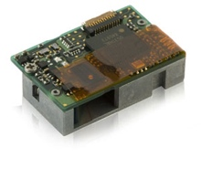
Design Considerations and Tradeoffs
Bell202 vs. RS232
Faster data transmission
Lowers power consumption
No microcontroller reduces hardware size
Marshalltown researched scanners and decided to provide the Opticon MDL1000.
iPod Barcode Scanner
Team May1310
Presenter: Jake

Slide 9
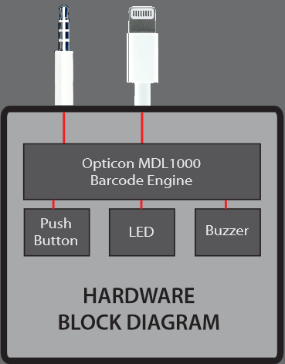
Hardware Description
The scan engine will read a barcode after the pushbutton is pressed.
Upon a successful scan, the engine will release RS232 barcode data to the microphone input of the iPod.
iPod Barcode Scanner
Team May1310
Presenter: Jake
Notes:
Jake

Slide 10
Schematic
iPod Barcode Scanner
Team May1310
Presenter: Jake
Notes:
Jake

Slide 11
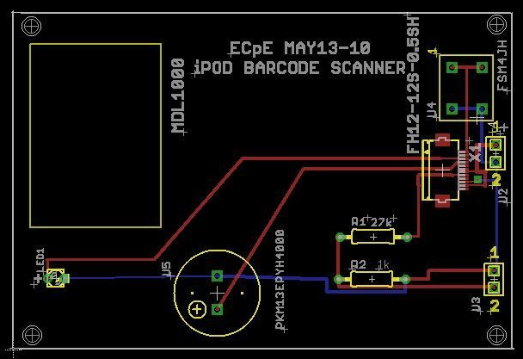
Layout
iPod Barcode Scanner
Team May1310
Presenter: Jake
Notes:
Jake

Slide 12
Software Description
The software for the iPod Touch will support the functionality to receive data from the barcode scanner.
We have developed a test app with a user interface.
Implemented using the Audio Units architecture provided by the Core Audio framework in iOS.
Baud Rate: 9600
Maximum Barcode Length: 50 Characters
iPod Barcode Scanner
Team May1310
Presenter: Kodi
Notes:
Kodi

Slide 13
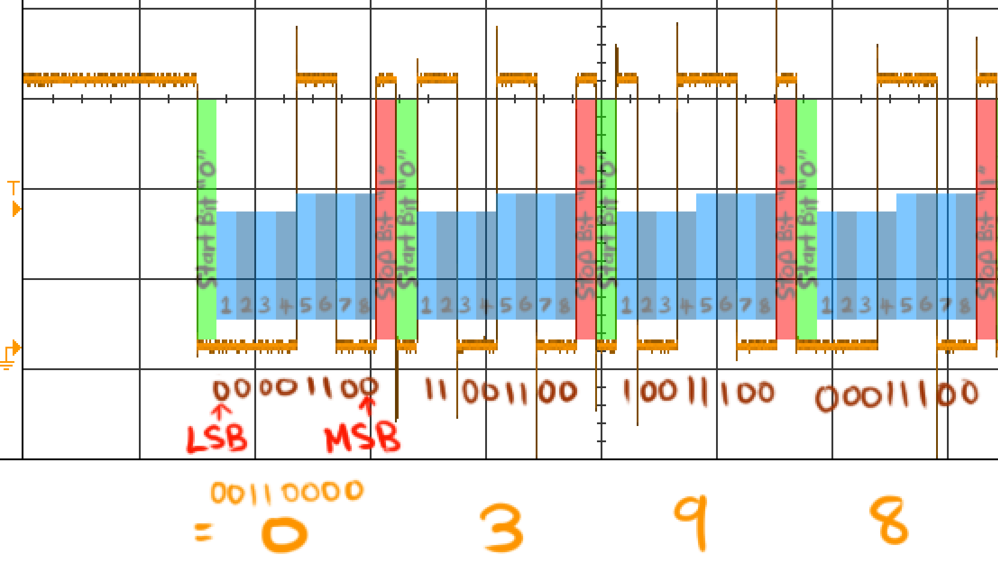
Software Description
Oscilloscope Output From Scan Engine
iPod Barcode Scanner
Team May1310
Presenter: Kodi
Notes:
Kodi

Slide 14
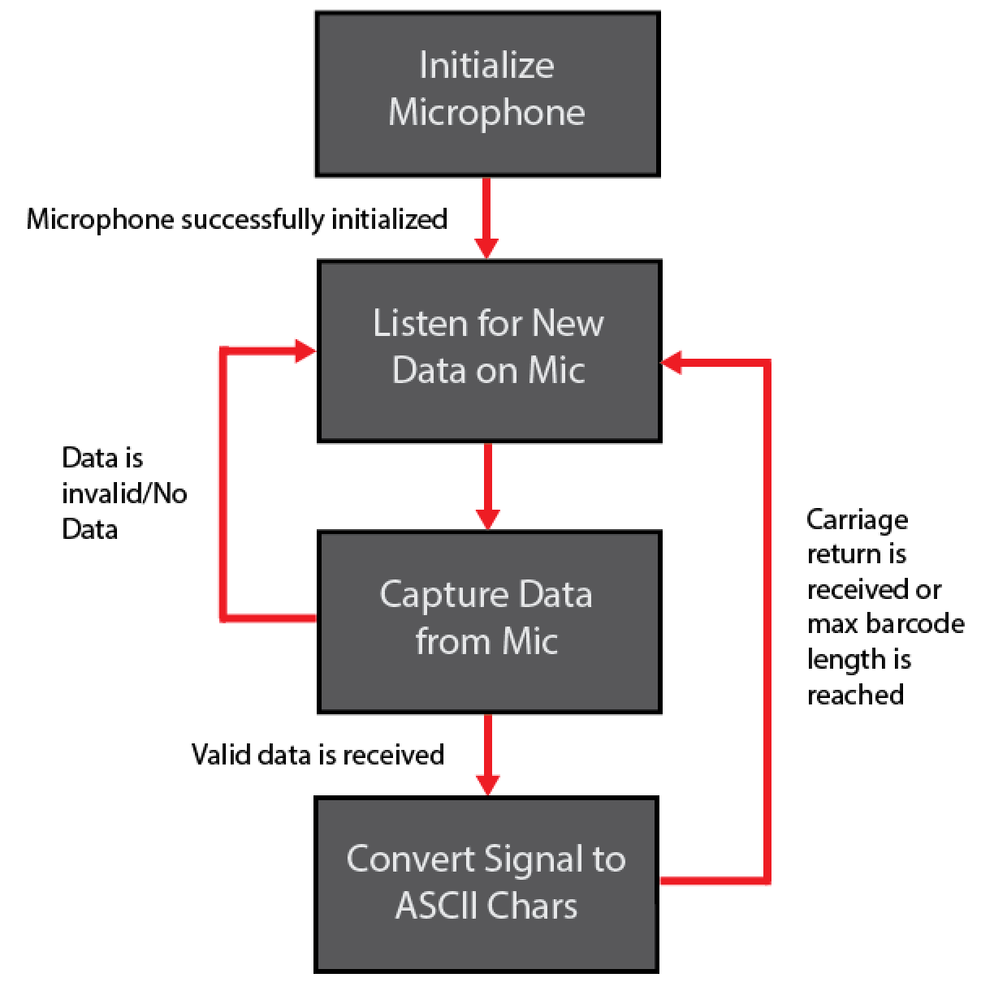
Software Block Diagram
iPod Barcode Scanner
Team May1310
Presenter: Kodi
Notes:
Kodi

Slide 15
Standards
TRRS - The interface standard we use to transfer data to the iPod
RS232 - The standard we use to define our communication protocol
GS1 Standard for Universal Product Code (UPC) - Main barcode type used by Marshalltown
PCB Standard
iPod Barcode Scanner
Team May1310
Presenter: Mike
Notes:
Mike

Slide 16
Scanner Testing
Scanner data verified for UPC type barcodes (A-Z, 0-9)
Maximum Scanner Distance: 30 cm
Battery Testing
Confirmed battery life exceeds 8 hours
Test Conditions:
Intermittent scanning: 10 consecutive scans followed by a 5 minute sleep (3 hours)
Continuous usage: ~20 scans/hour without sleeping (5 hours)
iPod Barcode Scanner
Team May1310
Presenter: Mike
Notes:
Mike

Slide 17
Resources
Team Website: http://seniord.ece.iastate.edu/may1310
Marshalltown Company: http://www.marshalltown.com
Opticon: http://www.opticonusa.com
iPod Barcode Scanner
Team May1310
Notes:
Ipod Barcode Scanner
Group May 1310
Client: Marshalltown (maybe)
Presenter Names on slides

Slide 18
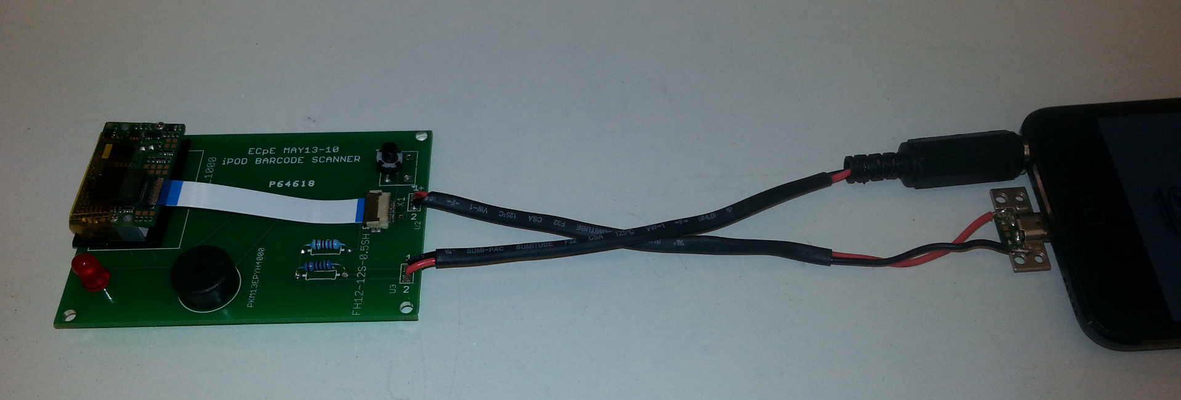
DEMO
iPod Barcode Scanner
Team May1310

Slide 19
Questions?
Thank you for your attention
iPod Barcode Scanner
Team May1310

Slide 20
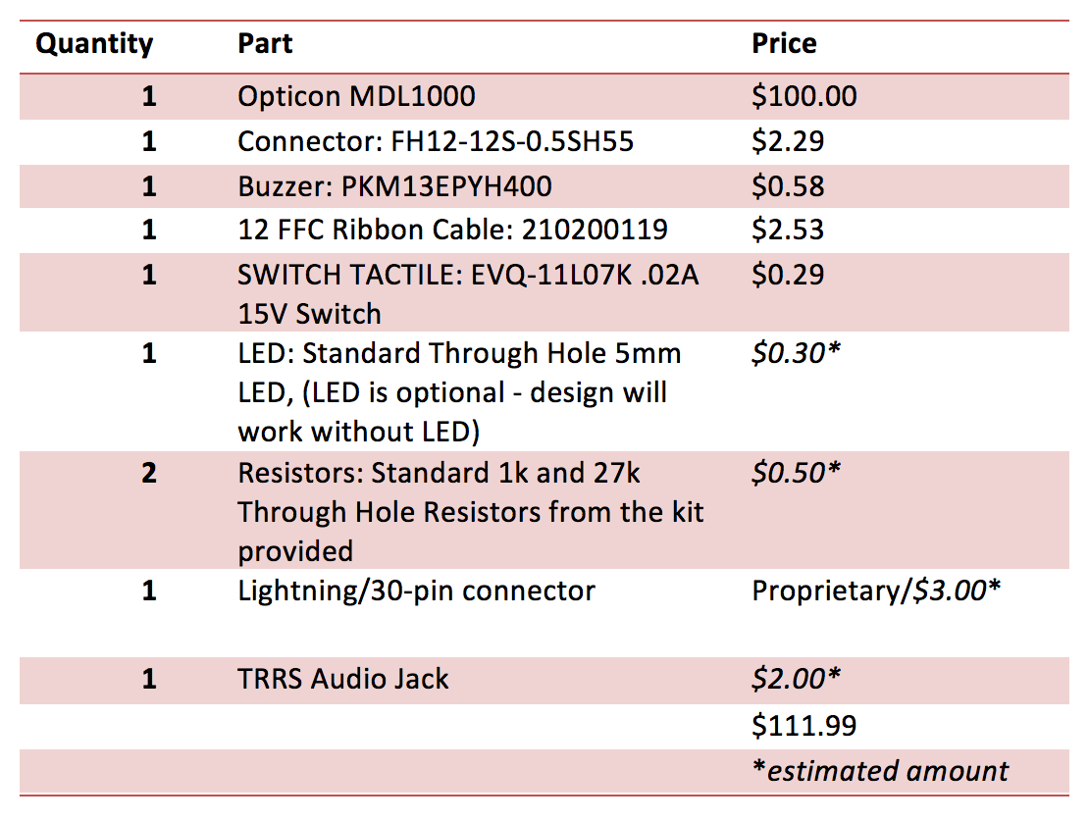
Cost
iPod Barcode Scanner
Team May1310
Presenter: Mike
Notes:
Mike

Slide 21
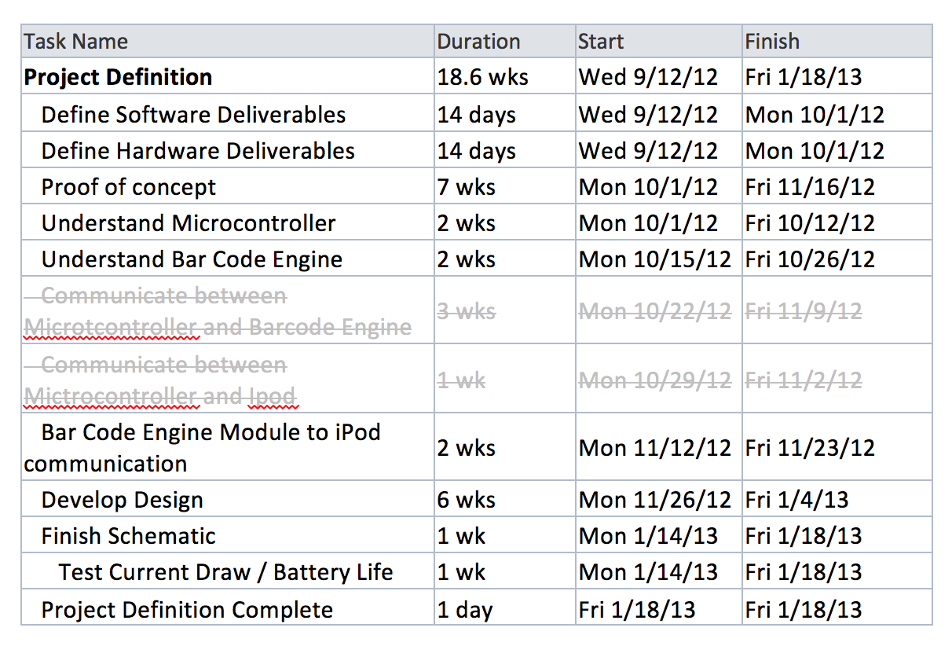
Schedule
iPod Barcode Scanner
Team May1310
Presenter: Taylor
Notes:
Taylor

Slide 22
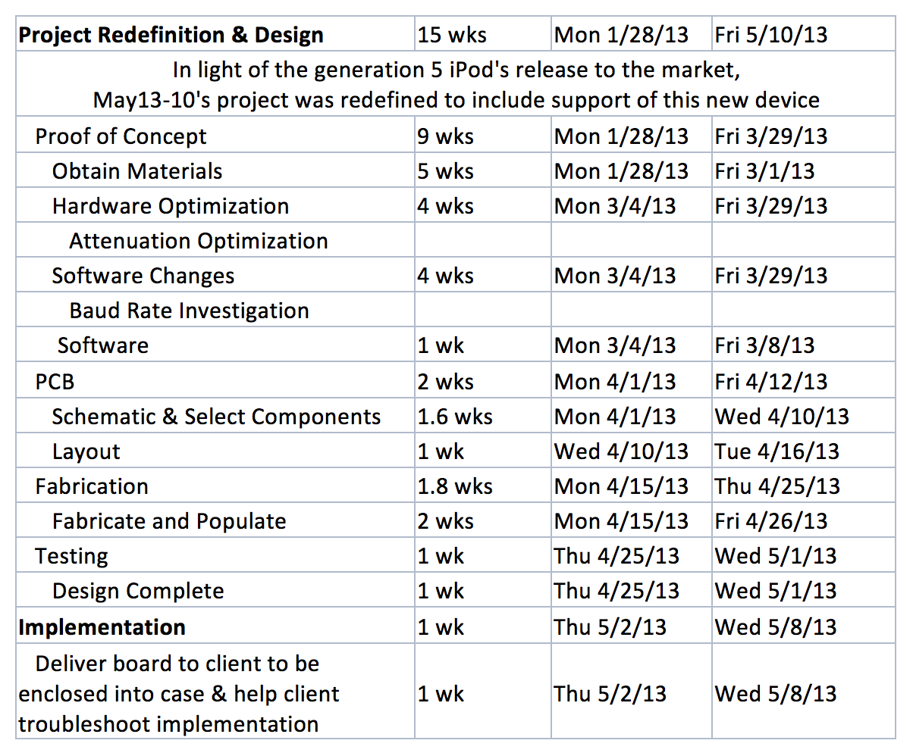
Schedule
iPod Barcode Scanner
Team May1310
Presenter: Taylor
Notes:
Taylor

Slide 23
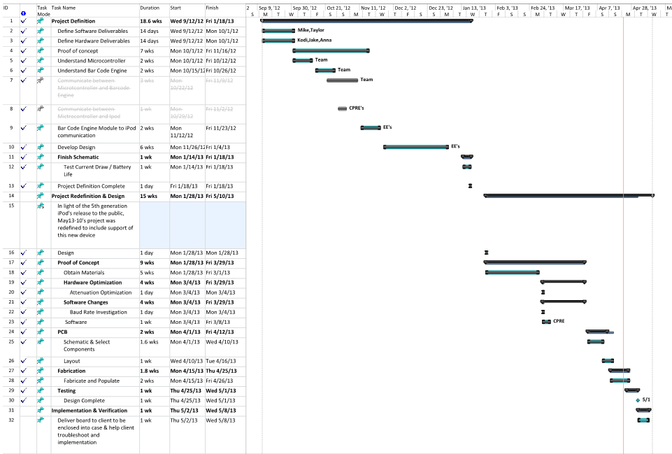
iPod Barcode Scanner
Team May1310
Presenter: Taylor
Notes:
Taylor

