Slide 1
PowerCyber SCADA Test Bed
Team Dec13_11:
Cole Hoven
Jared Pixley
Derek Reiser
Rick Sutton
Adviser/Client: Prof. Manimaran Govindarasu
Graduate Assistant: Aditya Ashok

Slide 2
PowerCyber Test Bed Team DEC13_11
Cole Hoven Computer Eng.
Jared Pixley Electrical Eng.
Derek Reiser
Computer Eng.
Richard Sutton
Electrical Eng.

Slide 3
What is a SCADA System?
“Supervisory Control and Data Acquisition”
A computer controlled Industrial Control System (ICS) that monitors and controls vital industrial processes
includes Power Transmission and Distribution, Oil, Gas, and Water

Slide 4
SCADA System Breakdown
Control Center:
Human-Machine Interface (HMI).
Lets human operator view and control processed data
Supervisory Station:
Consists of servers, software and stations
Provides communication between the Control Center and RTU’s.
Notes:
Control Center: Usually consist of a Human-Machine Interface (HMI). This let a human operator view processed data and control that same process.
Supervisory Station: This element consists of the servers, software and stations responsible for providing communication between the Control Center and RTU’s.
Remote Terminal Unit (RTU): Typically connected to physical equipment. The RTU is used to convert electrical signals from hardware sensors to digital data which is collected by the supervisory station.
Sensor: A device that measures an analog or status value in some element of a process. A sensor collect the raw process data used to make decisions about a process.

Slide 5
SCADA System Breakdown Cont.
Remote Terminal Unit (RTU):
Typically connected to physical equipment.
Collected by the supervisory station.
Sensor:
Measures an analog or status value in an element of a process.
Collects raw process data used to make decisions.

Slide 6
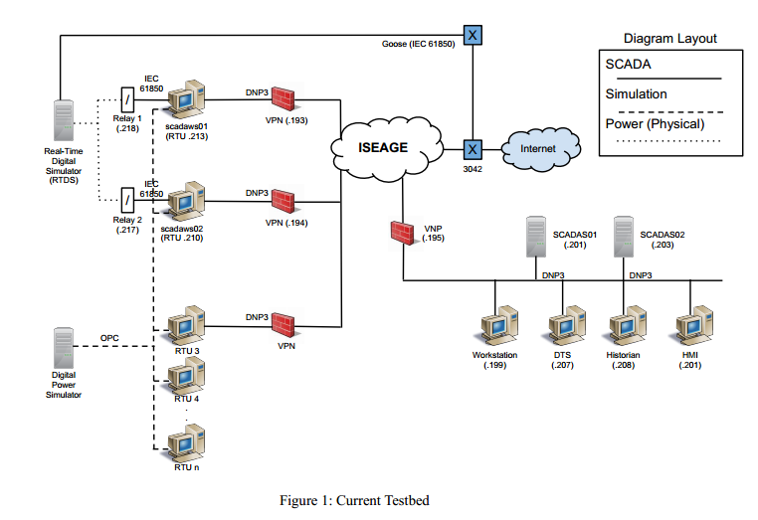
High Level Current Testbed

Slide 7
Project Overview
The PowerCyber testbed provides realistic electric grid control infrastructure
Uses a combination of physical, simulated, and emulated components
Provides an accurate smart grid representation

Slide 8
Test Bed Research Capabilities
Cyber vulnerability assessment
Attack impact analysis
Mitigation strategy evaluations
Cyber-physical system studies

Slide 9
Problem Statement
Electric power grid highly automated and complex network
Monitors, protects and controls
Security of SCADA systems are at risk
Security analysis of live systems is not practical
Lack of cyber-physical systems research
Testbed recently developed

Slide 10
Functional Requirements This Semester
SEL_421 connected to system
Understanding MU security analyzer
Functioning 9 bus model
Implement automatic breaker and power generation control logic
Notes:
1) Integrate the OPAL-RT simulator into the current testbed.
i) Create a 9 bus system for the OPAL-RT simulator in RT-LAB and
Simulink
ii) Make physical connections with components in the current
testbed
iii) Set up proper data transfer between the simulator and testbed
iv) Run functional tests to assure successful integration
2) Integrate the SEL PMU’s into the testbed.
i) Connect PMU’s with current testbed
ii)Set up proper data transfer between the simulator and testbed
iii)Run functional test to assure successful integration
3) Integrate a 30 bus system into the testbed.
i) Create a 30 bus model for the OPAL-RT Simulator in RT-LAB and Simulink
ii) Implement 30 bus model with simulator and the rest of the testbed
4) Set up remote access capabilities.
i) Create a remote login server
ii) Automate the testbed software
iii) Run “the demo” remotely

Slide 11
Nonfunctional Requirements
Power system models properly formatted
SEL-421 connected directly to RTU
More realistic setup than being connected to command center directly

Slide 12
Assumptions
Test equipment will function properly.
Industry standard devices
Simulated devises function identical to physical devises
Test bed is similar to a real-world SCADA system.
Systems protocols accurately portray real-world protocols
Simulation results will be relevant to industry/research
Test bed will be continuously improved upon

Slide 13
Limitations
We have two semesters to complete the project.
Only 120V will be used by the relays.
Real-world systems exceed more than 230kV.
Only 2 physical relays will be used due to physical, financial and time limitations.
Other relays will be simulated.

Slide 14
Risks and Mitigation
Risks
Causing current system to be non-functional
If SEL PMU can be connect to the RTU
If testbed software can be started remotely
Learning curve
Mitigation
Test system after adding components
Trial and error: Want SEL to connect to RTU
Test software early to find limitations and issues
Continue working and ask questions

Slide 15
New Components
Several new devices are going to be added to the testbed
OPAL-RT Simulator
SEL-421
SEL-3378

Slide 16
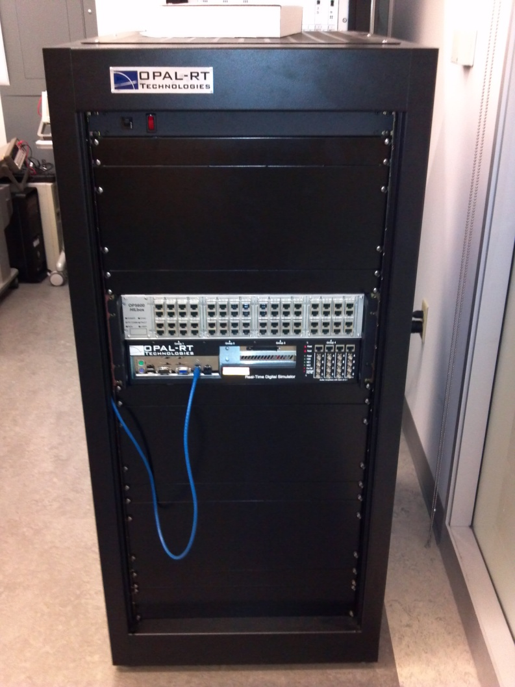
Opal-RT
OPAL-RT Technologies OP5600 HIL Box
Real Time Digital Simulator (RTDS)
Hardware-in-the-loop
Advanced monitoring capabilities, scalable I/O and processor power
More flexible to meet needs of testbed
Easier to create and run new testbed models

Slide 17
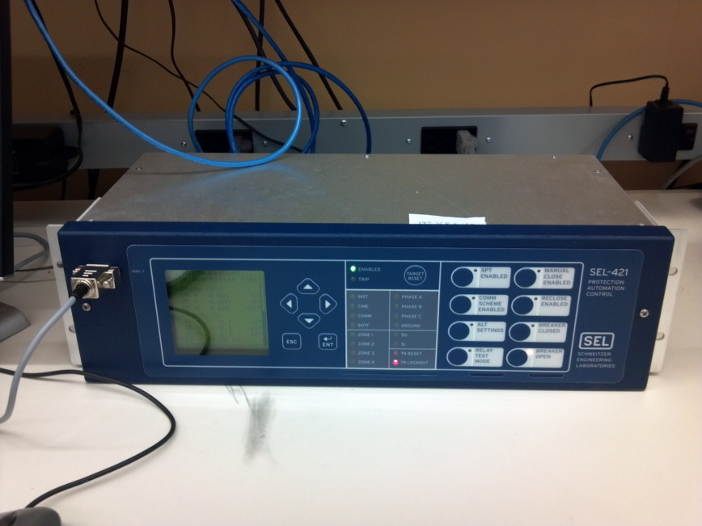
SEL-421 (Relay)
Schweitzer Engineering Laboratories
Protection Automation System
Circuit breaker automation and control
More accurate actions due to High-Accuracy Time Stamping (10 ns)
More functionality and control than current Siemens devices

Slide 18
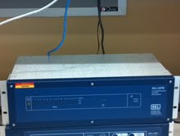
SEL-3378
Schweitzer Engineering Laboratories
Synchrophasor Vector Processor
Control center for all SEL Phasor Modulation Units (PMU’s)
Collects data and sends out predefined actions to be carried out by SEL devices

Slide 19
RT-LAB/Simulink Models
RT-LAB
Runs a specified Simulink model on the OPAL-RT simulator
Special “OP-COM” blocks used and allow for monitoring and control of data
Simulink
Models created using block sets
Data transfer over different protocols for compatibility with devices
Notes:
Simulink
Models created using block sets to simulate a power system
Allows for data transfer over different protocols for compatibility with devices

Slide 20
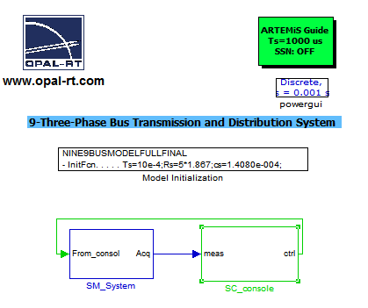

Slide 21
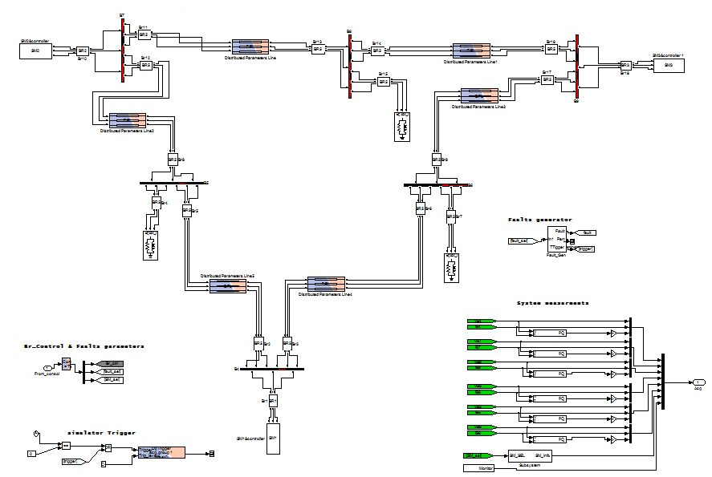

Slide 22
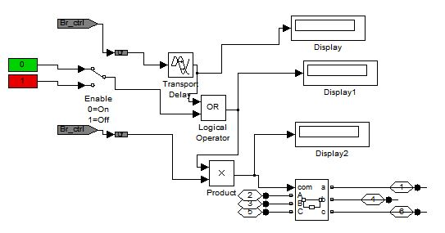
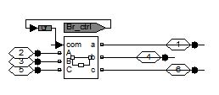
Automatic Breaker Control
Original Breaker Circuit
New Breaker Circuit With Logic
Notes:
When one breaker trips, the other is on a time delay.

Slide 23
Current Status
Functioning 9 bus model in Simulink
Run test simulation on 9 bus model
Continue working on model data transfer through IEC61850 protocol
SEL PMU connected to the network -Set communication protocols for SEL -Used security tools on current network

Slide 24
Next Semesters Plan
Transfer of data between model and testbed components
Integration of the OPAL-RT Simulator
Complete 30 bus model in Simulink
Remote access server
Connect the SEL processor
Run further impact analysis
Notes:
Remote access server (front end and back end)
Run further impact analysis and compare to previous results

Slide 25
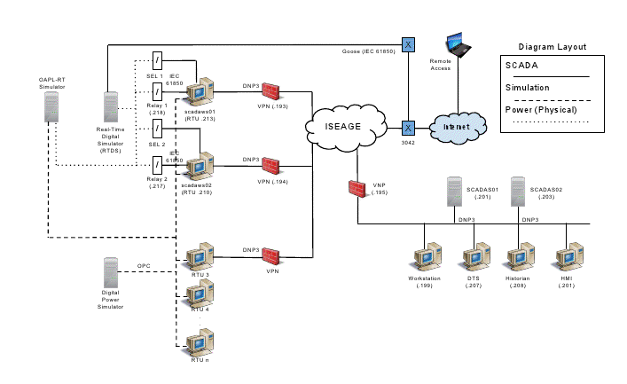
High Level Future Testbed Plan

Slide 26
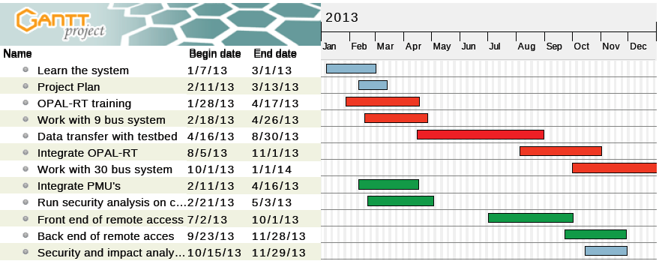
Project Milestones and Schedule

Slide 27
Questions?

